Slide 1

Hospital Management Information System (HMIS)
Submitted by: Hrishikesh Tiwari (CS22M047)
Under the guidance of: Prof. John Augustine

Slide 2
Improving in-hospital patient management, EMR automation, medical data interoperability and security with a blockchain-based Hospital Management Information System.

Slide 3

Contents
Introduction
Abstract
Existing Solutions
2. State of the art
Why Blockchain
Types of Blockchain Network
3. Hyperledger Fabric
HLF
Fabric Components
Consensus Mechanism
4. Current Work
Smart Contracts
Chaincode Implementation Details
Steps to use the application
Smart Contracts Hierarchy
5. Security
Ransomware Attack
DDOS Attack
Network Sniffing Attack
6. Future Work
7. References

Slide 4
Introduction
Abstract
Existing Solutions

Slide 5

1.1 Abstract
In today’s dynamic healthcare landscape, efficient patient management and electronic medical record (EMR) automation are critical for enhancing healthcare services. The proposed system utilizes blockchain technology to create a decentralized, transparent, and immutable ledger for patient data, ensuring the integrity, security, and interoperability of health records. This innovative approach not only facilitates seamless access to accurate patient information for healthcare providers but also empowers patients to have control over their data, enhancing patient privacy and consent management.
The project aims to design and develop a blockchain-based Hospital Management Information System (H-MIS) that integrates patient management and EMR automation, also ensure data security, privacy, and integrity using blockchain technology. The security part involves improving the resistance of the HMIS towards various attacks(Ransomware attack, Network Sniffing, DDOS, ,etc). By leveraging smart contracts, the system automates and streamlines various healthcare processes, from billing to insurance claims, improving efficiency and reducing administrative costs.

Slide 6
1.2 Existing Solutions
Currently, Electronic Health Record (EHR) Systems are widely used, which serve as electronic representations of patients’ medical records. EHRs digitally store various important patient information like medical histories, diagnoses, medication details, and treatment protocols, essentially replacing traditional paper charts. Additionally, Health Information Exchange (HIE) Systems are employed by hospitals. These systems enable efficient exchange of patient information among various healthcare providers and entities, enhancing the coordination of patient care. Despite their transformative impact on healthcare administration, these systems face certain challenges. For instance, EHR and HIE systems often encounter difficulties with interoperability, hindering the seamless exchange of information across diverse platforms and systems. Furthermore, securing patient data is a critical issue, as hospitals and healthcare organizations frequently become targets of cyber attacks.

Slide 7
2. State of the art
Why Blockchain
Types of Blockchain Networks

Slide 8
2.1 Why Blockchain
Here are some ways in which blockchain can be useful in the context of HMIS:
Data Security and Integrity: Blockchain's immutable nature ensures that once data is recorded, it cannot be altered or deleted without consensus from the network. This is crucial for maintaining the integrity of medical records, patient information, and other sensitive data.
Interoperability: Blockchain can facilitate data exchange and interoperability between different departments, hospitals, and healthcare systems. This can lead to improved patient care by ensuring that accurate and up-to-date information is accessible to authorized parties.
Medical Records Management: Using blockchain, medical records can be securely stored, accessed, and shared among authorized healthcare professionals while maintaining patient privacy. This can streamline patient care by providing a comprehensive view of the patient's medical history.
Consent Management: Blockchain can help manage patient consent for data sharing and treatment decisions. Patients can provide explicit consent for specific data access, enhancing transparency, and patient control.
Decentralization of Data: Traditional HMIS might involve centralized databases vulnerable to data breaches. Blockchain decentralized nature can distribute data across the network, making it more resistant to hacking attempts.

Slide 9

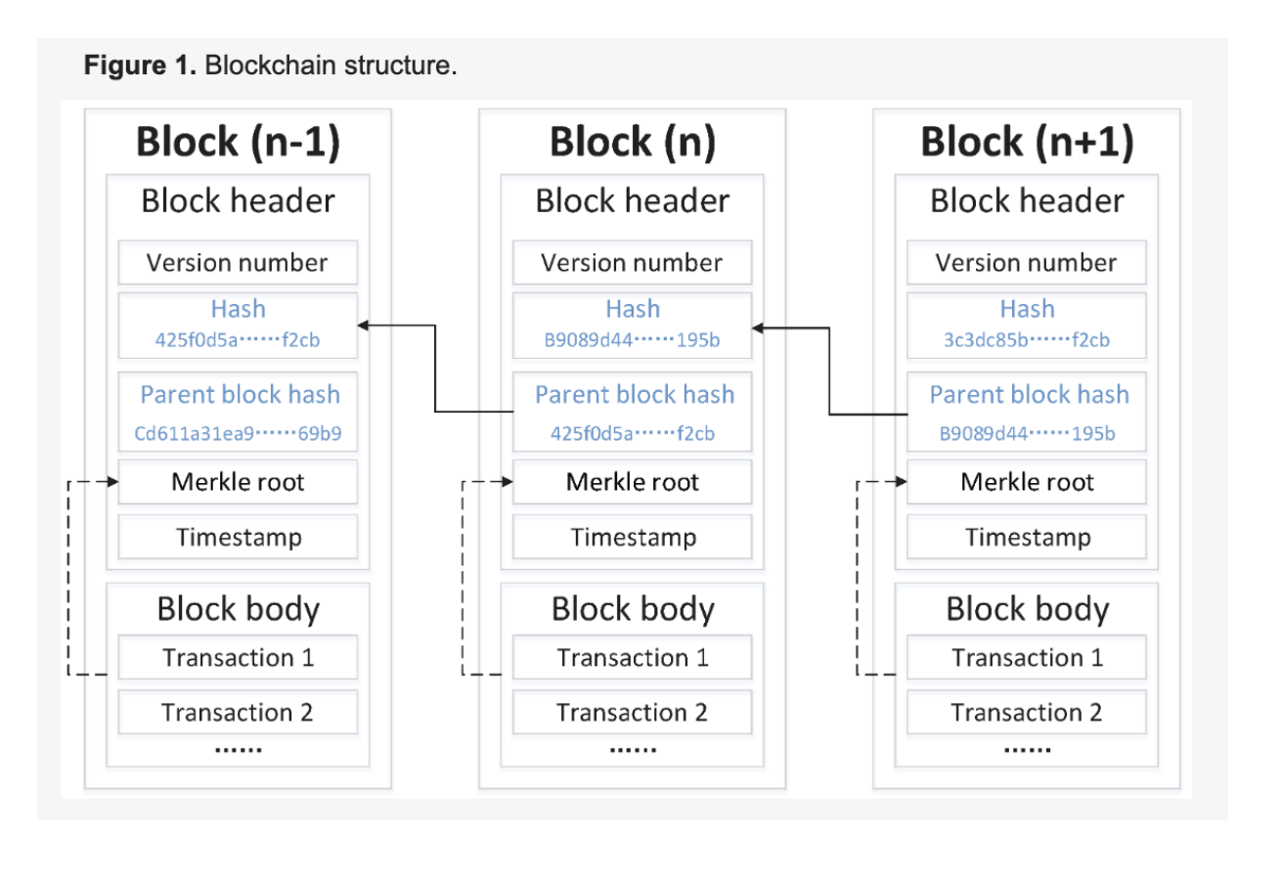

Slide 10
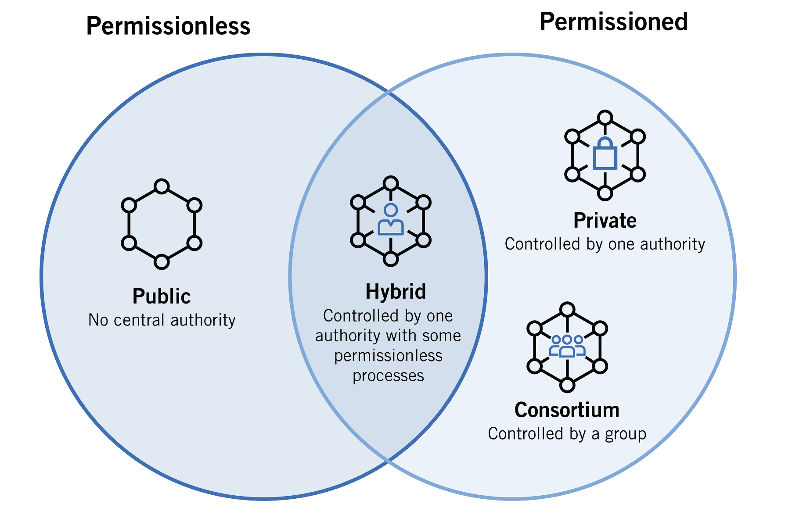
2.2 Types of blockchain network

Slide 11
○ Public Blockchains: These blockchains operate as open and unrestricted networks where participation, ledger access, and transaction validation are available to all without specific permissions. They are highly decentralized, relying on a large number of nodes to secure the network. Examples: Bitcoin and Ethereum are well-known public blockchains.
○ Private Blockchains: Private blockchains restrict participation to a predefined group of known entities. Participants are typically vetted and authorized. These networks offer greater control and privacy but sacrifice some degree of decentralization. They are often used for internal business processes, supply chain management, and consortiums. Examples: Hyperledger Fabric and Corda.
○ Consortium Blockchains: These are governed by a group of organizations or consortium members, who collectively make decisions about the network so these are semi-permissioned. While more controlled than public blockchains, they offer a balance between decentralization and permissioned access. Ideal for industries or groups where multiple entities need to collaborate while maintaining some level of trust. Examples: Quorum and B3i.
○ Hybrid Blockchains: Hybrid blockchains combine elements of both public and private blockchains. Some parts of the ledger may be public, while others are private. They are suitable for scenarios where transparency and privacy must coexist, such as in supply chain tracking. Examples: Dragonchain and VeChain.

Slide 12
3. Hyperledger Fabric
HLF
Fabric Components
Consensus Mechanism

Slide 13
3.1 Hyperledger Fabric
○ HLF is an open source project created to enable blockchain technology for use in a business context with strict
requirements on privacy, confidentiality, and organisation-driven structure.
○ Where Hyperledger Fabric breaks from some other blockchain Systems (like ethereum) is that it is private and
permissioned. Rather than an open permissionless system that allows unknown identities to participate in the
network (requiring protocols like “proof of work” to validate transactions and secure the network), the members
of a Hyperledger Fabric network enroll through a trusted Membership Service Provider (MSP). Permissioned
nature of Hyperledger Fabric ensures privacy, integrity and data confidentiality.
○ Hyperledger Fabric also offers the ability to create channels, allowing a group of participants to create
a separate ledger of transactions. This is an especially important option for networks where some
participants might be competitors and not want every transaction they make a special price they’re
offering to some participants and not others. If two participants form a channel, then those participants and no
others have copies of the ledger for that channel.

Slide 14
3.2 Fabric Components
○ Peers
Peers are the nodes in the network responsible for maintaining a copy of the ledger and executing chaincode. Peers
validate transactions, maintain ledger copies, and participate in the consensus Process. They are a fundamental
component of the network.
○ Chaincode
HLF distinguishes between smart contracts and chaincode in the documentation. Chaincode is used interchangeably
with the word smart contract, but they have slightly different meanings. A smart contract is a collection of functions
that carry out terms agreed upon by all parties participating in the transaction. A chaincode on the other hand is a
package of multiple smart contracts, and is what you deploy to a channel. Multiple smart contracts are packaged into a
single chaincode which is then deployed to a blockchain network. When a chaincode is deployed, all smart contracts
within it are made available to applications.
○ Ledger
A transaction log that records all transactions in chronological order. The ledger maintains a transparent and
immutable record of all network activities. The blockchain is a ledger of all transactions. It provides a
tamper-proof history of all transactions and ensures data integrity.

Slide 15
○ Channel
Channels are used to partition the network into private sections. Each channel has its own ledger and only
includes specific network participants. This allows for data isolation and privacy.
○ Endorsement Policy
The endorsement policy describes which members from which organisations in the channel must endorse or
approve smart contract transactions. If the transaction is not endorsed as required, the transaction is rejected.
○ Ordering node
An orderer is a single node within the ordering service. Multiple orderers work together to form the ordering service.
Orderers receive transactions from multiple channels and order them into blocks. The blocks are then distributed to peer
nodes, which update their ledgers accordingly. Basically they are responsible for managing the order and confirmation of
transactions before they are added to the blockchain ledger. It ensures the consistency and sequence of transactions.
○ Ordering Service
The ordering service accepts the endorsed transactions from clients, orders them into blocks, and then delivers
these blocks to the peer nodes. It is made up of multiple orderer nodes that work together to provide a
fault-tolerant, decentralized system. The ordering service does not process transactions or smart contracts; its
main function is to agree on the order of transactions and then package them into blocks.

Slide 16
○ Identity
In Hyperledger Fabric, an identity represents a unique entity that participates in the network, such as users,
peers, or any component that interacts with the blockchain. An identity is associated with a unique
cryptographic certificate issued by a trusted Certificate Authority (CA). The certificate is used to sign
transactions and messages, ensuring the authenticity and integrity of communications within the network.
The example is that some card terminals may accept only Visa, while others only American Express, and
others again may accept both American Express as well as Visa.
○ Membership Service Provider (MSP)
MSP manage identities, certificates, and related information. It handles tasks like validating
certificates, managing revocation lists, and assigning roles to identities, ensuring a comprehensive and
secure identity management system. The MSP defines the rules by which identities are validated,
authenticated, and allowed access to a network.
○ Certificate Authority
A node is able to participate in the blockchain network, via the means of a digital identity issued for it by an
authority trusted by the system. The CA issues X.509 certificates to network participants, ensuring secure
authentication and encrypted communication. CA ensures the identity and trustworthiness of participants,
enabling secure interactions.

Slide 17

○ Transaction lifecycle
Transaction Proposal:
The transaction begins with a proposal from a client application. This proposal specifies the desired changes to
the ledger and includes endorsements from endorsers who verify that the transaction is valid.
Endorsement:
The proposal is sent to endorsing peers (typically a subset of the network) who simulate the transaction, validate it, and attach their digital signatures if the transaction is valid.
Ordering:
Endorsed transactions are collected by orderer nodes to form a block. The orderer nodes arrange transactions in the desired order and create blocks. Each block contains a set of ordered transactions.
Consensus:
The orderer nodes broadcast the blocks to all peers. Peers validate the transactions within the block to ensure they comply with the rules defined by the smart contracts. Consensus is achieved among peers regarding the validity of transactions.
Commitment:
After consensus is reached, peers commit the block to their local copy of the ledger. The transaction is now considered final and part of the ledger's history.
State Update:
The execution of valid transactions results in updates to the state database. These changes are recorded in the world state, reflecting the new state of assets or data.
Notification:
Once a transaction is successfully committed, events or notifications can be generated to inform client
applications about the transaction's status.

Slide 18
○ Chaincode lifecycle
Install
The chaincode is packaged into a format that can be deployed to peers on the network. Each organisation that wishes to use the chaincode installs it on their peers.
Approve for Deployment
In a permissioned network, a chaincode must be approved by a set of organisations before it can be deployed to
the network.
Commit Chaincode
After approval, the chaincode is committed to the channel. This is where the smart contract becomes active and operational. Once committed, it can be instantiated on the network.
Instantiate
The instantiation stage creates an instance of the chaincode on a specific channel, allowing it to be used. This process can involve providing parameters or configuration specific to the chaincode. After instantiation, the chaincode is available for clients to interact with.
Invoke and Query
Once the chaincode is instantiated, clients can send transactions to invoke the chaincode's functions and query
its state. These transactions are processed, and changes to the ledger are recorded.
Upgrade
Over time, you may need to update the chaincode to introduce new features, fix bugs, or make other
improvements. The upgrade process involves installing a new version of the chaincode, approving it for
deployment, and then upgrading the existing chaincode on the channel.

Slide 19
3.3 Consensus Mechanism
Hyperledger fabric uses Practical Byzantine Fault Tolerance (pBFT) consensus algorithm. PBFT is a well-established consensus protocol that is designed to provide high levels of security and fault tolerance in distributed systems.
PBFT ensures that a consensus is reached among the network nodes even in the presence of malicious or faulty nodes (up to one-third of the total nodes in the network) and that transactions are processed in a deterministic and ordered manner. HLF uses pBFT by default. Raft and Kafka-based ordering service are the other options.
Leader Selection: In a PBFT-based network, a leader (also known as the primary or primary replica) is selected through a round-robin or other rotation method. The leader proposes a block of transactions to be added to the blockchain.
Pre-Prepare Phase: The leader sends the proposed block to the other nodes in the network. Each node, upon receiving the block, validates it and broadcasts a "pre-prepare" message if the block is valid.
Prepare Phase: Once a node receives pre-prepare messages from more than two-thirds of the network nodes, it sends out a "prepare" message. This message indicates that the node has validated the proposed block and is ready to commit it to the blockchain.
Commit Phase: After receiving a sufficient number of prepare messages (again, typically more than two-thirds of the network), a node broadcasts a "commit" message. The commit message signifies that the node is ready to add the block to the blockchain.
Transaction Finalization: Once a node receives commit messages from more than two-thirds of the network nodes, it considers the block as committed and adds it to the blockchain. The transactions within the block are considered final.

Slide 20
Hyperledger Fabric employs Practical Byzantine Fault Tolerance (pBFT) as its consensus mechanism. To maintain system stability, pBFT requires a total of 3N + 1 nodes, with ’N’ representing the maximum number of nodes that can malfunction. Consequently, for any decision to be made within the network, it necessitates the endorsement of 2N + 1 nodes. This approach allows for decentralized consensus without relying on intricate mathematical computations, as seen in methods like proof-of-stake or proof-of-work.

Slide 21

4. Current Work
(General Hospital Management Information System Implementation)
Smart Contracts
Chaincode Implementation Details
Steps to use the application
Smart Contracts Hierarchy

Slide 22
4.1 Smart Contracts
There are three users in the system with roles admin, patient, and doctor.
Each user has its own use cases.
PrimaryContract: This contract initiates with patient personal details, the base patient class.
AdminContract: This contract is invoked by the admin. The methods in the contract give the admin the ability to create/delete patients by adding/deleting patient objects from the ledger. Admin can also view all the patients available throughout the network.
PatientContract: The patient interacts with the ledger by invoking this contract. The contract contains the logic that is required for the patient. For instance, only the patient can update/view the personal details and password via the methods defined in the contract. And also the patient contract contains methods to grant and revoke access to from a doctor.
DoctorContract: The doctor contract has methods that allow the doctor to update/read the patient's medical details.

Slide 23
Create patient
Delete patient
Admin
View patient details with limited information
Create doctor
Delete doctor

Slide 24
View personal details
View self details
View history of patient
Update personal details
View patient medical details
View history of own data
Patient
Doctor
Grant access to doctor
Update patient medical details
View list of patients who have given access
Revoke access to doctor
View list of doctors

Slide 25
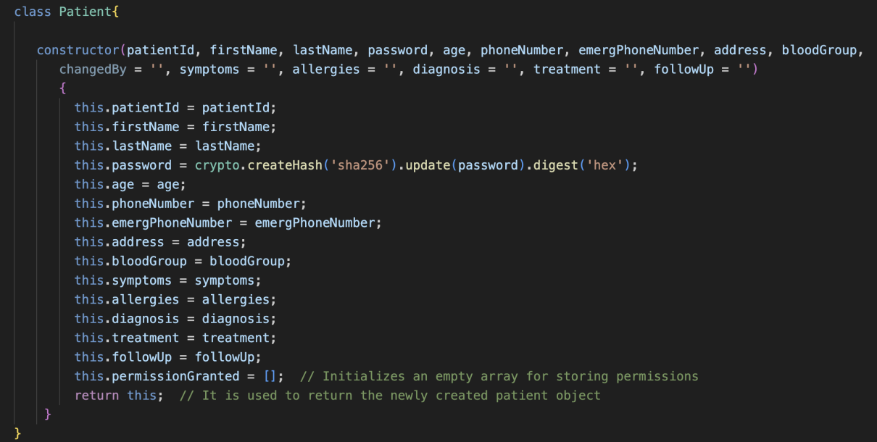
4.2 Chaincode Implementation Details
4.2.1 patientContract
Constructor method of the Patient class, is used to create a new patient object when an instance of the class is created. It takes several parameters representing various attributes of a patient, such as patientId, firstName lastName, password, and so on.

Slide 26
readPatient function first checks if a patient exists, and if so, it retrieves the patient’s data from the blockchain ledger, parses it into a JavaScript object, and returns a modified object with selected patient attributes. If the patient does not exist, it throws an error. The provided code defines an asynchronous function named getAllPatientResults within a Hyperledger Fabric smart contract. This function is responsible for retrieving and formatting results from an iterator obtained from a query on the blockchain ledger.
Patient Contract contains updatePatientPersonalDetails, updatePatientPassword, getPatientPassword, getPatientHistory, grantAccessToDoctor, revokeAccessToDoctor functions below are the examples of updatePatientPersonalDetails and grantAccessToDoctor code.

Slide 27
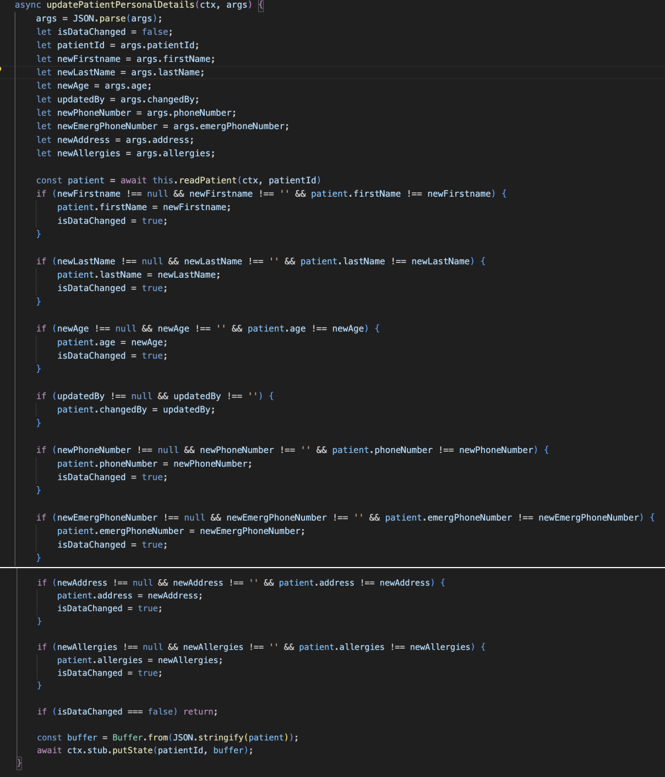

Slide 28
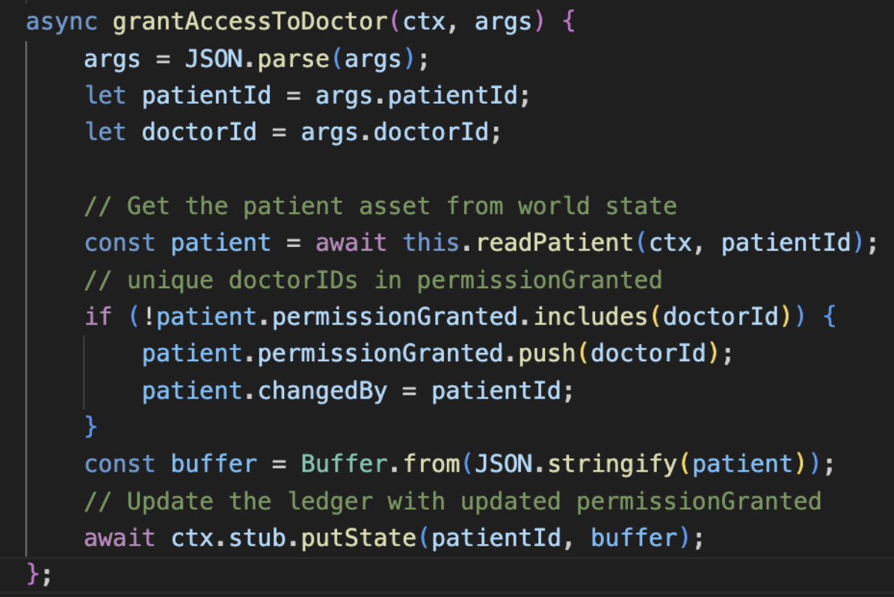

Slide 29
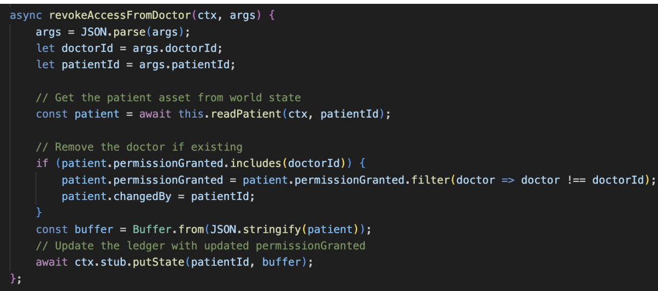

Slide 30
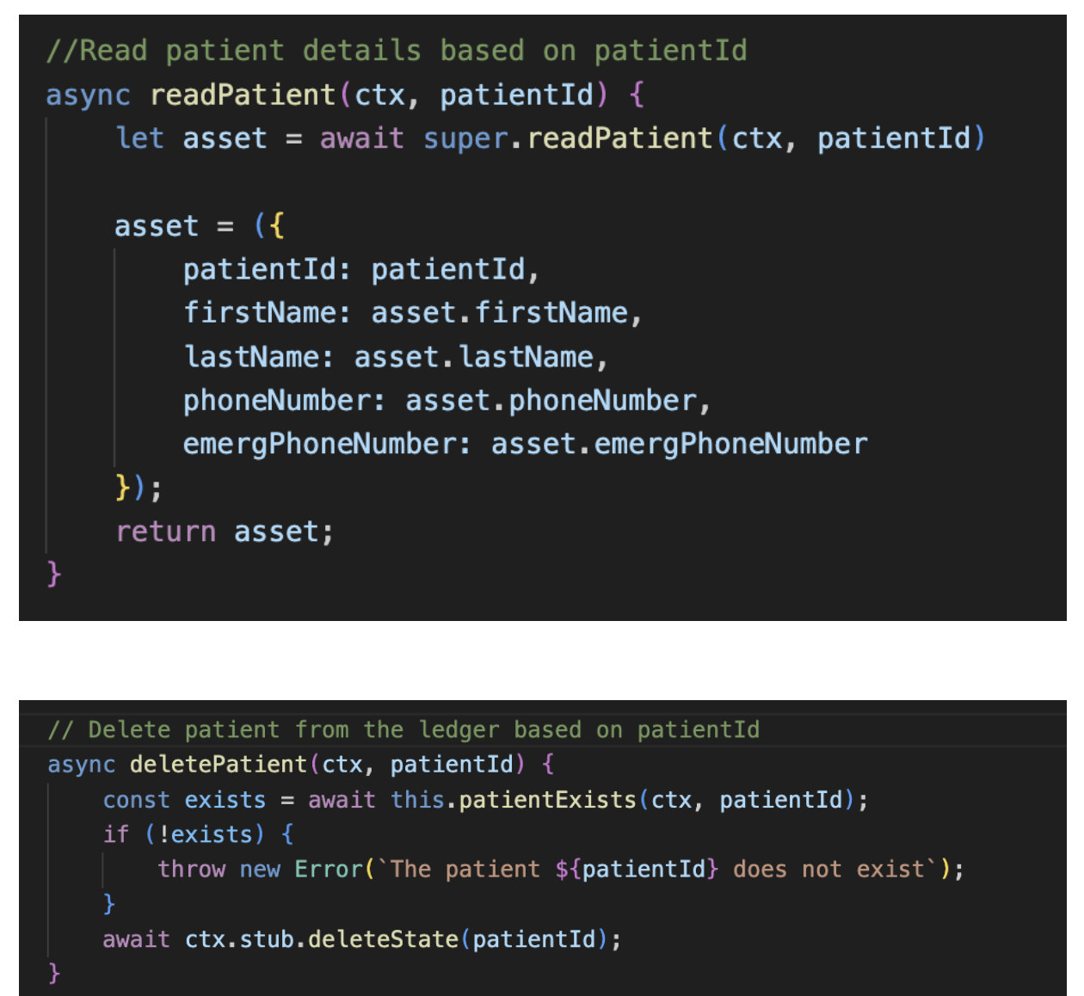
4.2.2 adminContract
It Contains createPatient, readPatient and deletePatient functions. Below is the readPatient code.

Slide 31
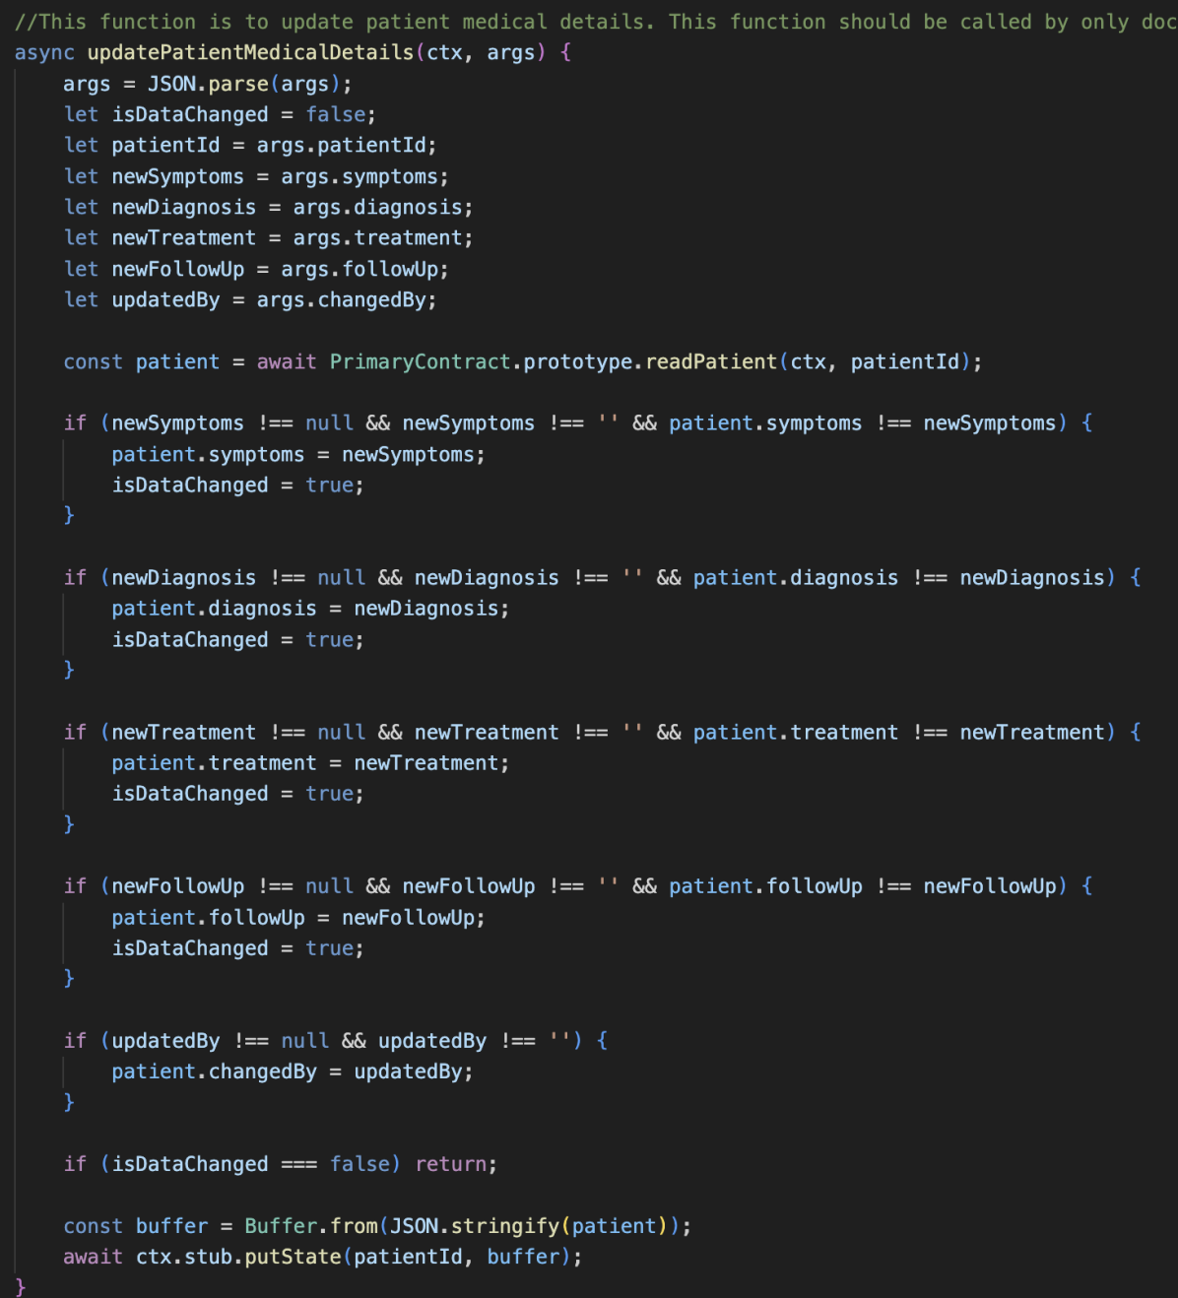
4.2.3 doctorContract

Slide 32
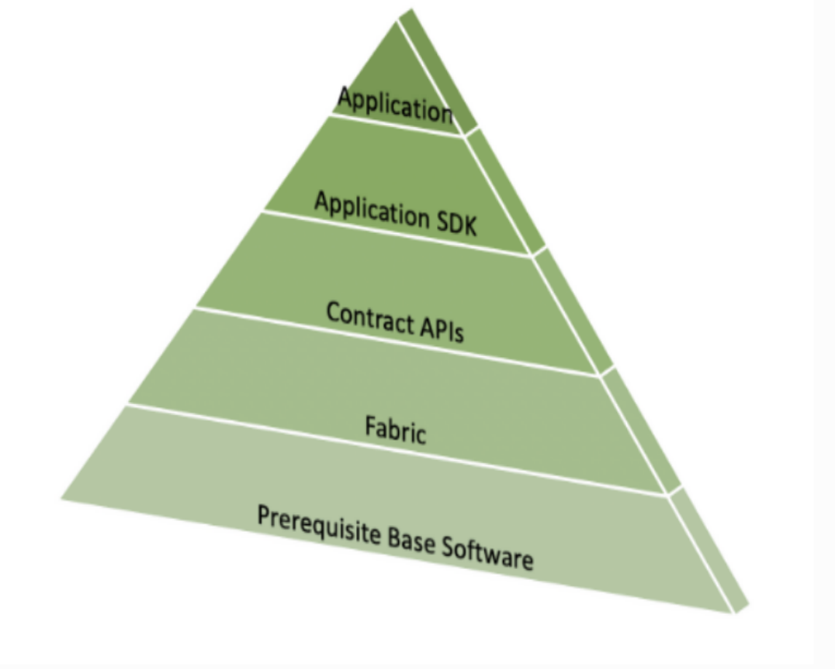
4.3 Steps to use the application

Slide 33
Duplicate the repository from GitHub, which is equipped with applications, resources, and configurations crucial for working with Hyperledger Fabric. In order to obtain the Docker containers and replicate the samples repository, execute the following instructions: Use ./install-fabric.sh docker samples binary to install the fabric samples, download
Hyperledger Fabric Docker images, and acquire Hyperledger Fabric binaries.
Following this, we can proceed to initiate the network.
down: The script ./network.sh is designed to shut down the network and remove any existing artifacts or containersleft over from previous executions, essentially clearing Docker containers.
up: The command ./network.sh up activates the network, establishing a fabric network comprising an Orderer node (org) and two peer nodes (org1, org2). Initially, no channel is formed, although docker containers are set up.
up createChannel: ./network.sh up createChannel is used for simultaneously initiating the network and establishing a channel in one combined action.
deployCC: Utilize ./network.sh deployCC -ccn basic -ccp ../asset-transfer-basic/chaincode-go -ccl go to initiate a chaincode on a channel, typically defaulting to asset-transfer-basic. Once a channel is established, you’re then able to begin utilizing smart contracts for interactions with the channel’s ledger.

Slide 34
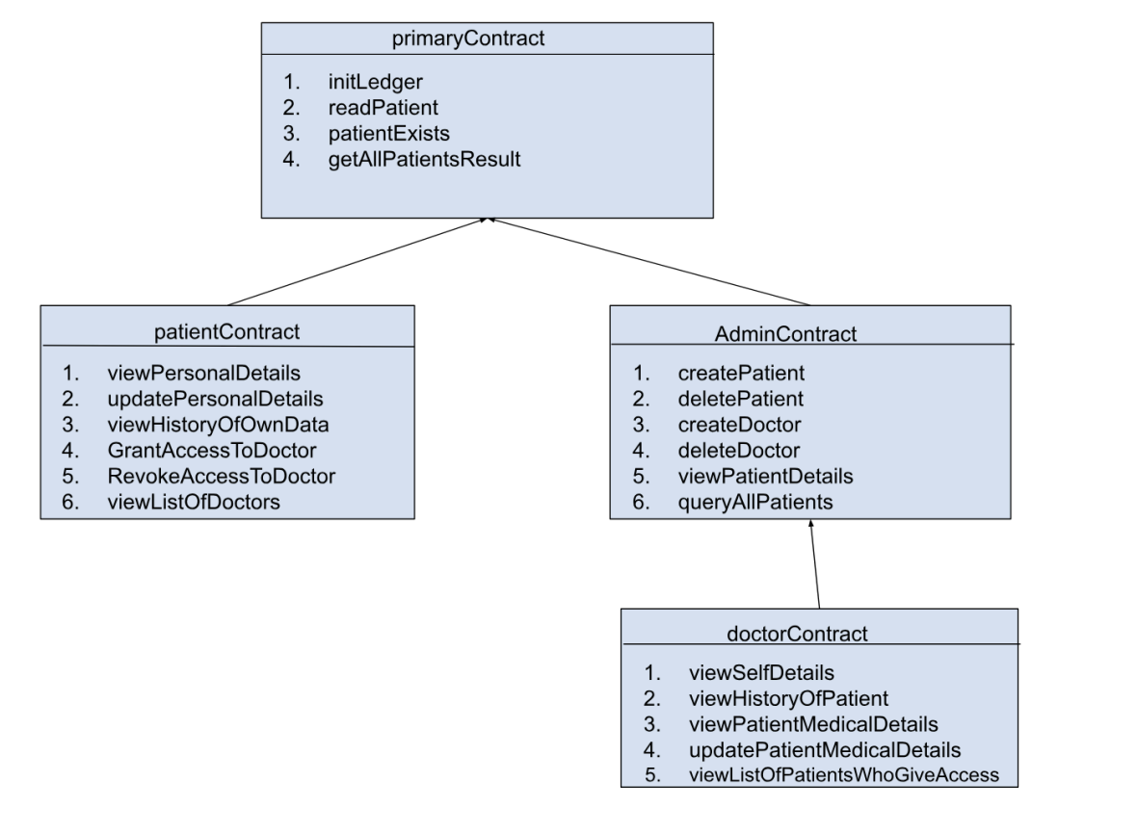
4.4 Smart Contracts Hierarchy

Slide 35

5. Security
Ransomware Attack
DDOS Attack
Network Sniffing Attack

Slide 36
How using blockchain provides better security for this attack as compared to a traditional system:
1. Decentralization: Blockchain functions through a network of nodes that are decentralized. In contrast to centralized systems, which are vulnerable at a single failure point, compromising a blockchain system would require overpowering a substantial part of its network. This dispersed structure of blockchain increases the difficulty for attackers to focus on and incapacitate the entire system.
2. Data Immutability: When information is logged onto a blockchain, changing or erasing it becomes exceedingly difficult without consensus from the majority of the network’s participants. Therefore, even in the event of an attack, the accuracy and consistency of the data are preserved.
3. Consensus Mechanisms: Blockchains utilize consensus protocols to authenticate and establish the sequence of transactions. These protocols play a crucial role in safeguarding against the inclusion of illegitimate or harmful transactions within the blockchain, guarding against any attempts by attackers to overwhelm the network
with a deluge of transactions.
4. Cryptography: Blockchain uses cryptographic techniques to secure data and transactions. These techniques make it extremely difficult for attackers to intercept, manipulate, or forge data during an attack.
5. Smart Contracts: Several blockchain platforms offer support for smart contracts, enabling the automation of specific security protocols. For instance, in the event of unusual network activity, smart contracts have the capability to momentarily restrict access or regulate inbound traffic, thereby lessening the severity of a DDoS attack.

Slide 37
6. Transparent Transactions: Blockchain’s transparency means that all transactions are visible to network participants. This transparency can help in identifying and isolating malicious traffic patterns during an attack.
7. Access Control: Systems based on blockchain technology can establish authentication protocols and robust access control, ensuring network access is limited to duly authorized users. This approach effectively minimizes the potential
attack surface by barring unapproved access.
8. Data Distribution: In blockchain networks, data is distributed across multiple nodes. Even if some nodes become inaccessible during an attack, other nodes can continue to operate and provide access to data and services.
9. Redundancy: Many blockchain networks have data redundancy across multiple
nodes. Even if some nodes are compromised by ransomware, other nodes can
continue to operate and provide access to data and services.

Slide 38
5.1 Ransomware Attack
Ransomware represents a form of a malware that locks and encrypts the files or systems of its victims, making them unusable. The perpetrators then ask for a ransom, usually in the form of cryptocurrency, to provide the decryption key needed to regain access to the locked files or systems.
Delivery Methods: Ransomware may be distributed via harmful attachments, deceptive phishing emails, compromised websites, or through flaws in software systems.
5.1.1 Challenges:
Data Accessibility: Ransomware can encrypt data, making it inaccessible to healthcare providers. This can have severe consequences, especially during emergencies.
Data Integrity: While blockchain provides data integrity, ransomware can potentially exploit vulnerabilities in smart contracts or other blockchain components to manipulate data.
Decryption Key Security: Securing the decryption keys is crucial. If attackers gain access to these keys, they can decrypt and potentially alter sensitive health data.
System Downtime: Ransomware can cause system downtime, impacting hospital operations and patient care.
Data Backup and Recovery: Ensuring that data backups are secure and up-to-date is essential to recover from a ransomware attack. However, managing backups in a decentralized blockchain system can be challenging.

Slide 39
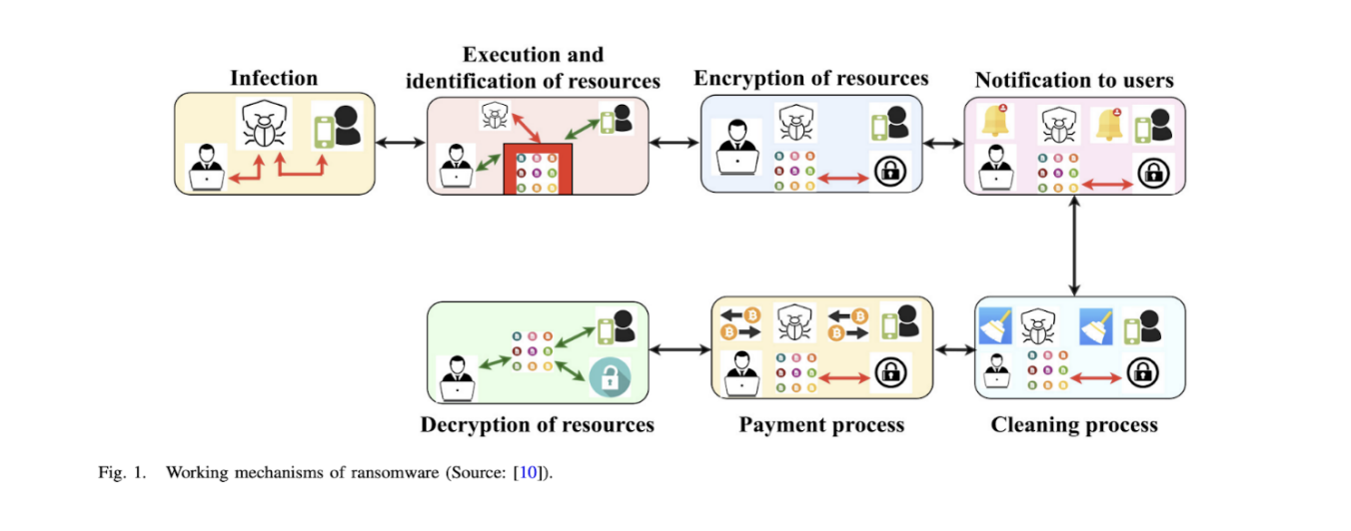

Slide 40
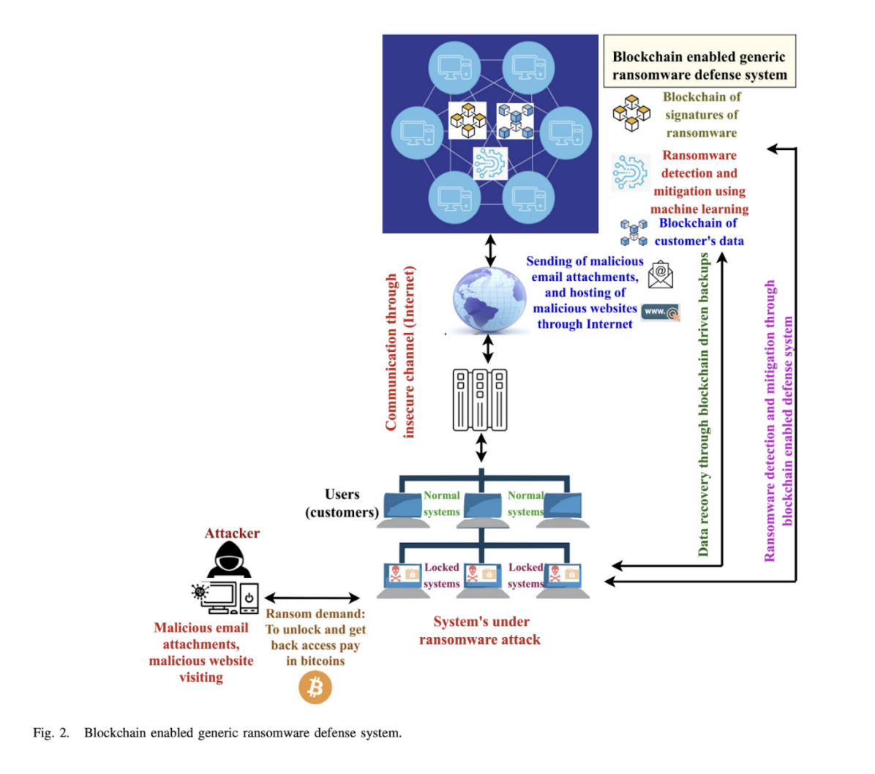

Slide 41
5.1.2 Existing Security Mechanism:
Data Encryption: Implement encryption for data whether it is stored (at rest) or being transferred (in transit) to safeguard it against unauthorized access.
Immutable Ledger: The immutable nature of the blockchain’s ledger means that once information is logged, it is permanent and cannot be altered or erased. This provides a safeguard against ransomware attacks that aim to encrypt or alter data.
Regular Backups: Regular backups of data, stored in a secure and decentralized manner, help ensure data recovery in case of a ransomware attack.
Smart Contracts: Use smart contracts to automate responses to ransomware attacks, such as isolating infected systems or revoking access.
Secure Key Management: Secure management of cryptographic keys used for encryption and decryption is crucial to prevent against unauthorized access.
Network Security: Establish robust network security protocols, including intrusion
detection systems, the deployment of firewalls, and encrypted communication
channels, to block the entry of ransomware.

Slide 42
7. User Training and Awareness: Inform users about the dangers posed by ransomware and provide training to
help them identify possible threats. This includes recognizing phishing emails, which are often used as gateways
for ransomware attacks.
8. Regular Software Updates and Patching: Maintain current versions of all software and systems, and implement
security updates to address weaknesses that ransomware could potentially exploit.
9. Incident Response Plan: Establish a clear and efficient incident response strategy to swiftly and effectively
manage a ransomware attack.
5.1.3 Better Solutions:
In order to thwart an external assault, wherein the Ransomware perpetrator endeavors to transmit a transaction containing the Ransomware attack link to encrypt the MHR outside the network, all phases of the external attack algorithm are detailed below.

Slide 43
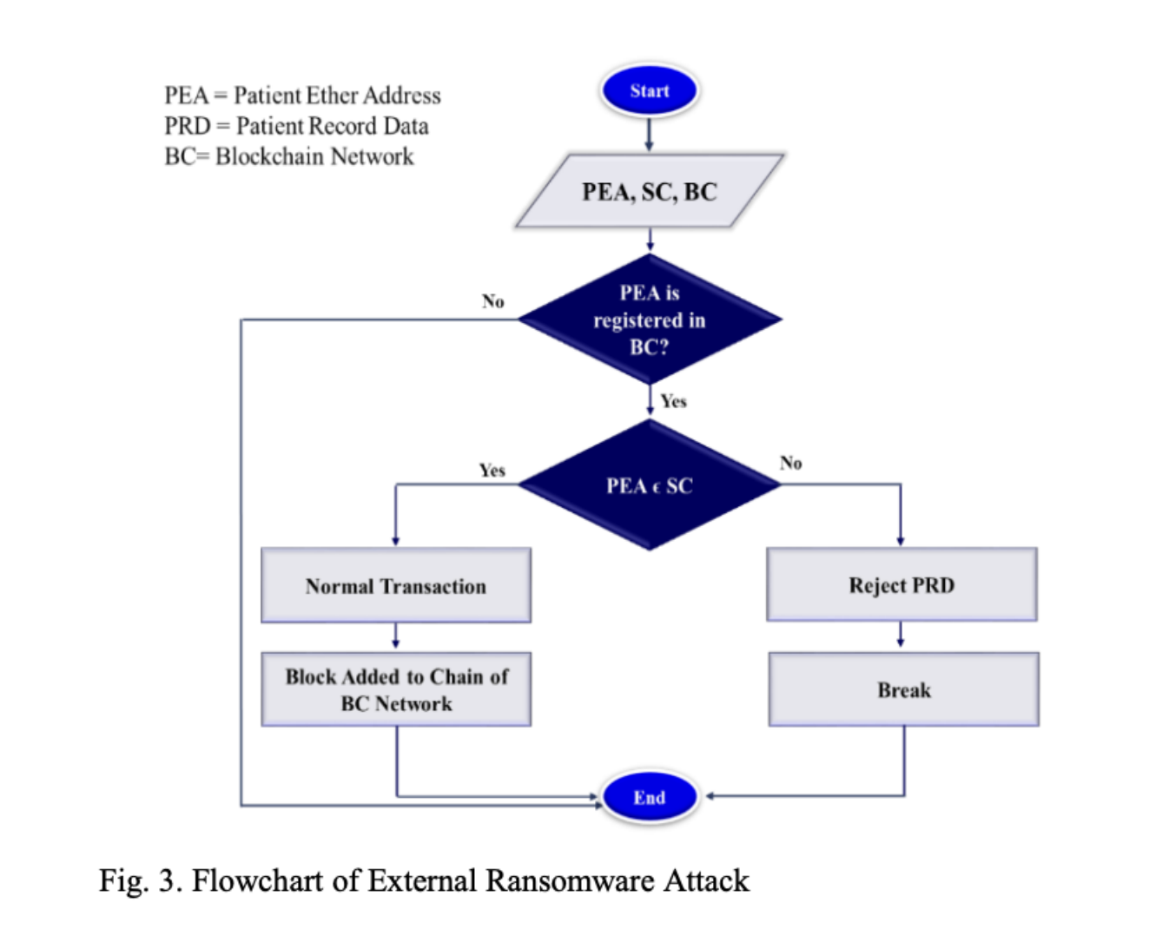

Slide 44
After the Medical Health Record (MHR) is uploaded to the application in the Hyperledger Fabric network, the smart contract initiates the verification process. It carefully examines the sender’s address to confirm its registration in the Blockchain network. It’s worth noting that all addresses associated with patients in the private Blockchain network can be easily identified. If the smart contract successfully validates the sender’s address as legitimate, it proceeds to verify the requested transaction, ensuring it contains data and is not empty. Once the validation is successful, the transaction is approved and executed. Conversely, if the smart contract cannot verify the sender’s address as registered, it takes actions to block the transaction request, preventing any further processing.
Following the upload of the Medical Health Record (MHR) to the Hyperledger Fabric application, the smart contract initiates a verification process. Initially, it verifies whether the sender’s identity and permissions are registered within the Hyperledger Fabric network, as all participant identities in the private network are already well-known. If the sender’s identity is recognized and holds the necessary permissions, the smart contract proceeds with the validation of the requested transaction. This validation encompasses confirming that the transaction is not empty and complies with any predefined data format or content restrictions set by the network’s policies. Transactions failing to meet these criteria are declined by the smart contract. In instances where the transaction is incorrect or unauthorized, the smart contract takes actions to prevent further transactions from that sender and may activate specific measures outlined in the network’s governance rules or policies.

Slide 45
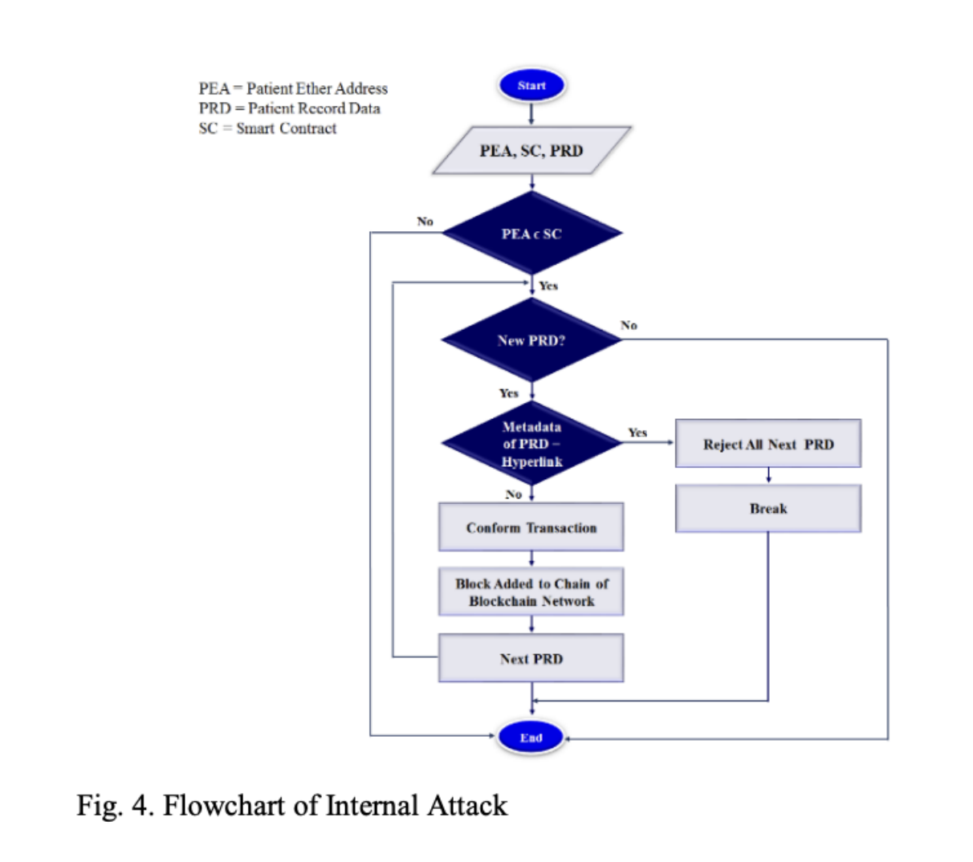

Slide 46
5.2 Network Sniffing
Network sniffing, also known as packet sniffing or network packet analysis, is a type of cyber attack that involves intercepting and inspecting the data packets flowing through a computer network. In the context of a blockchain-based hospital management information system, network sniffing can pose several security risks and privacy concerns. Here’s how network sniffing can impact such a system:
Data Interception: Network sniffers monitor and scrutinize data packets moving through the network. If the hospital management system’s communication channels lack adequate encryption, this could lead to a situation where an intruder might capture confidential patient information, personal data, encompassing medical histories, and financial specifics.
Privacy Violation: Sniffing attacks pose a significant threat to privacy by potentially allowing unauthorized individuals to obtain patients’ private medical records, treatment strategies, and other confidential data. Such breaches can lead to the illicit acquisition of personal health information (PHI), raising significant legal and ethical issues.
Credential Theft: Attackers may capture login credentials (such as usernames and passwords) sent in plaintext if the system lacks encryption. Once obtained, these credentials can be used for unauthorized access to the hospital management system or other related systems.
Data Manipulation: In addition to intercepting data, attackers with network access can modify or inject malicious data packets into the network stream. This could lead to false medical records, incorrect diagnoses, or altered treatment plans.
Distributed Denial of Service (DDoS): Network sniffing can be used to identify network weaknesses, which could be exploited to launch DDoS attacks on the blockchain-based system, causing network disruption and downtime.

Slide 47
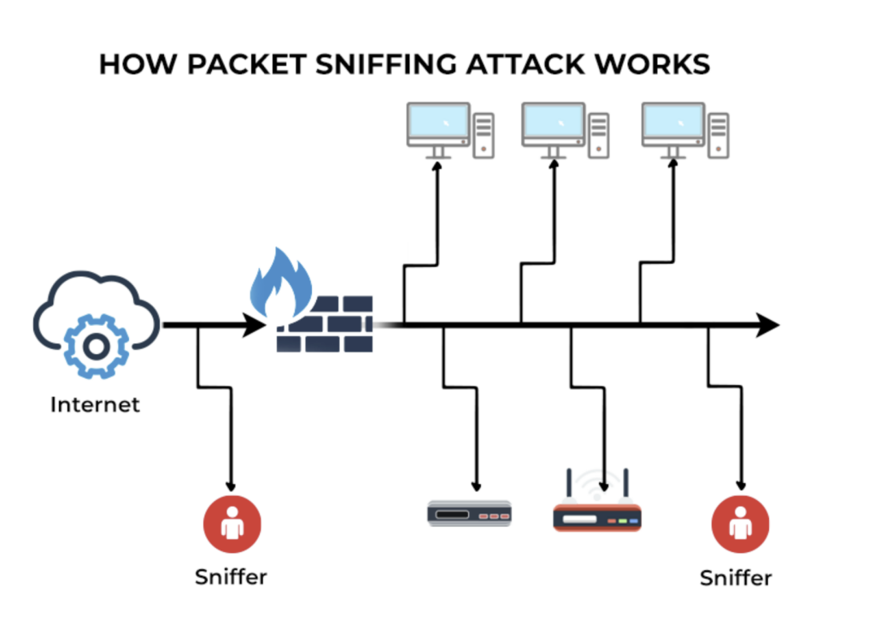

Slide 48
5.2.1 Challenges:
Data Sensitivity: Hospital management information systems handle highly sensitive and personal health information, which, if intercepted, can have severe consequences for patient privacy and data security.
Blockchain Vulnerabilities: While blockchain is considered secure, it is not completely immune to attacks. If an attacker can intercept network traffic, they may be able to exploit vulnerabilities in the blockchain protocol or smart contracts.
Network Security: Hospitals and healthcare organizations may not have robust network security measures in place, making them vulnerable to network sniffing attacks.
Encryption Limitations: While data on a blockchain is typically encrypted, data in transit may not always be fully secured, providing opportunities for sniffing attacks.
5.2.2 Existing Security Mechanism:
Encryption: Utilizing robust encryption protocols like HTTPS and SSL/TLS for data in transit guarantees that intercepted data remains challenging to decipher or manipulate.
Secure Wireless Networks: Employing secure wireless protocols like WPA3 to safeguard wireless networks against unauthorized entry and eavesdropping 32 attempts.

Slide 49
3. VPN (Virtual Private Network): Using VPNs to create secure communication channels that can protect data from
being intercepted during transmission.
4. Blockchain Security: Leveraging the built-in security attributes of blockchain, such as cryptographic hashing, digital
signatures, and agreement mechanisms, to guarantee the integrity and legitimacy of data.
5. Secure Channel for Key Exchange: Ensuring secure channels for exchanging cryptographic keys, which are used for
encryption and decryption, to prevent key interception.
6. Systems for the Detection and Prevention of Intrusions: Enforcing the intrusion detection and prevention systems
for the purpose of overseeing network traffic and identifying possible instances of sniffing attacks.
7. Regular Security Audits: Performing routine security audits and vulnerability assessments to detect and rectify
potential system weaknesses.
8. User Training and Awareness: Teaching individuals about security best practices and providing training to help
them identify potential threats can contribute to the prevention of sniffing attacks.
9. Access Control: Enforce robust access control measures to guarantee that sensitive information is only accessible
to individuals with proper authorization.
10. Monitoring and Logging: Monitoring network traffic and maintaining logs to identify any unusual or suspicious
activity that could indicate a sniffing attack.

Slide 50
5.2.3 Better Solutions:
Use fixed node identities and uphold a secure peer roster to deter attackers from introducing counterfeit nodes into the network. Introduce robust access control measures within the blockchain network to limit entry to authorized individuals exclusively. Evaluate the adoption of IPv6 in place of IPv4 to bolster network
security and diminish vulnerability to address-centric attacks.
Utilize secure communication protocols such as HTTPS and encrypted channels to safeguard blockchain-related information, encompassing usernames and passwords. Opt for a switched network design instead of hubs to guarantee that data is exclusively directed to its intended recipients within the blockchain network.
To enhance security within the blockchain environment, introduce password-based authentication for shared directories and services to thwart unauthorized entry.

Slide 51
5.3 DDOS Attack
A DDoS (distributed denial of service) attack is a type of attack that attempts to overwhelm a network by flooding it with a large amount of traffic. The goal of this type of attack is to prevent the HMIS from being accessible to its target users, which is usually healthcare providers or patients. A DDoS attack can happen in a number of ways, but one of the most common is a DDoS attack on a Blockchain-based Hospital.
Here’s how it can happen in a Blockchain-Based HMIS:
Overloading Blockchain Nodes: Attackers may target the blockchain nodes that are part of the HMIS, attempting to overwhelm them with traffic in order to prevent them from processing and validating transactions.
Targeting Network Infrastructure: Attackers may also target the underlying network infrastructure of the HMIS, such as servers and data centers, with the goal of overloading them and causing a system outage.
Exploiting Smart Contracts: If the HMIS utilizes smart contracts, attackers could exploit vulnerabilities in the smart contracts to create conditions that lead to a DDoS attack.
A DDoS (Distributed Denial of Service) attack on a blockchain-based Hospital Management Information System (HMIS) could have serious consequences, potentially hindering healthcare providers’ access to crucial patient data, thereby jeopardizing patient treatment. Such an attack might also lead to financial repercussions and harm the reputation of the medical facility. To counteract the threat of DDoS attacks, it is essential to deploy strong cybersecurity strategies, including the use of firewalls, systems for detecting and preventing intrusions, and services specifically designed for DDoS attack mitigation.

Slide 52
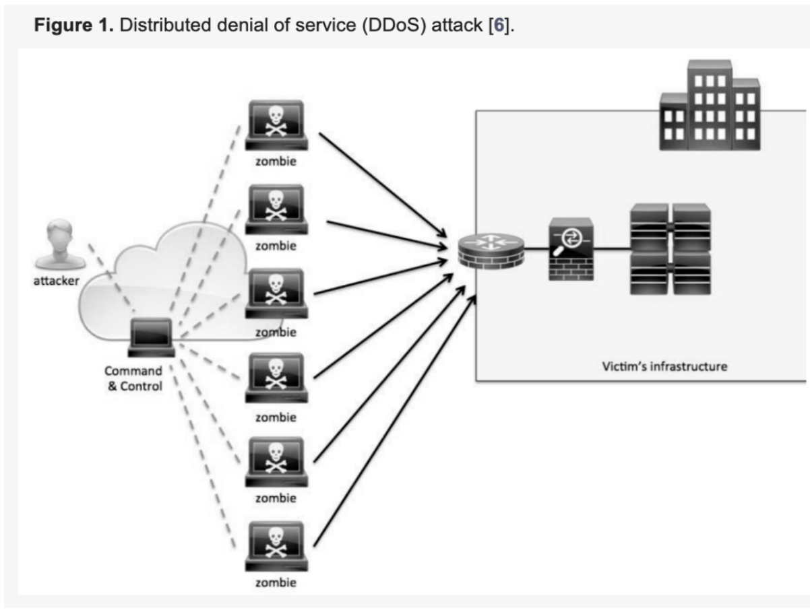

Slide 53
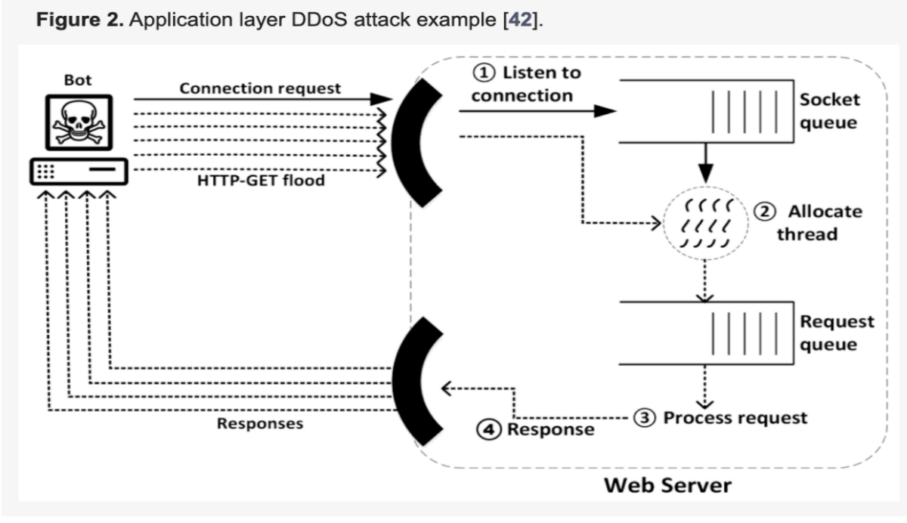

Slide 54
5.3.1 Challenges:
Network Overload: A DDoS attack involves overwhelming the network with a flood of internet traffic, which can lead to the network being overloaded and becoming slow or completely unavailable.
Blockchain Node Overload: The blockchain nodes may be targeted to disrupt the validation and processing of transactions, potentially causing delays or halting the blockchain operation.
Smart Contract Vulnerabilities: If smart contracts are employed in the HMIS, DDoS attacks can exploit vulnerabilities in the smart contracts to create conditions that overload the system.
Scalability Issues: Blockchains typically have limitations on the number of transactions they can process per second. A DDoS attack can exploit this limitation to cause a backlog of transactions, resulting in delays in data recording and retrieval.
Mitigation Resource Consumption: Addressing a DDoS attack requires significant resources, such as processing power and storage, which can be costly.
Legal and Regulatory Compliance: Hospitals are subject to strict legal and regulatory requirements for data protection and patient privacy. A DDoS attack that compromises the HMIS could lead to violations of these regulations.
Patient Care Disruption: In the healthcare setting, any disruption in the availability of patient information can have serious consequences for patient care. A DDoS attack that disrupts the HMIS could potentially jeopardize patient safety.
Financial Implications: A DDoS attack can have financial implications for the healthcare institution, including the costs of mitigating the attack and potential fines for regulatory non-compliance.
Reputation Damage: A successful DDoS attack can damage the reputation of the healthcare institution, potentially leading to a loss of patient trust.

Slide 55
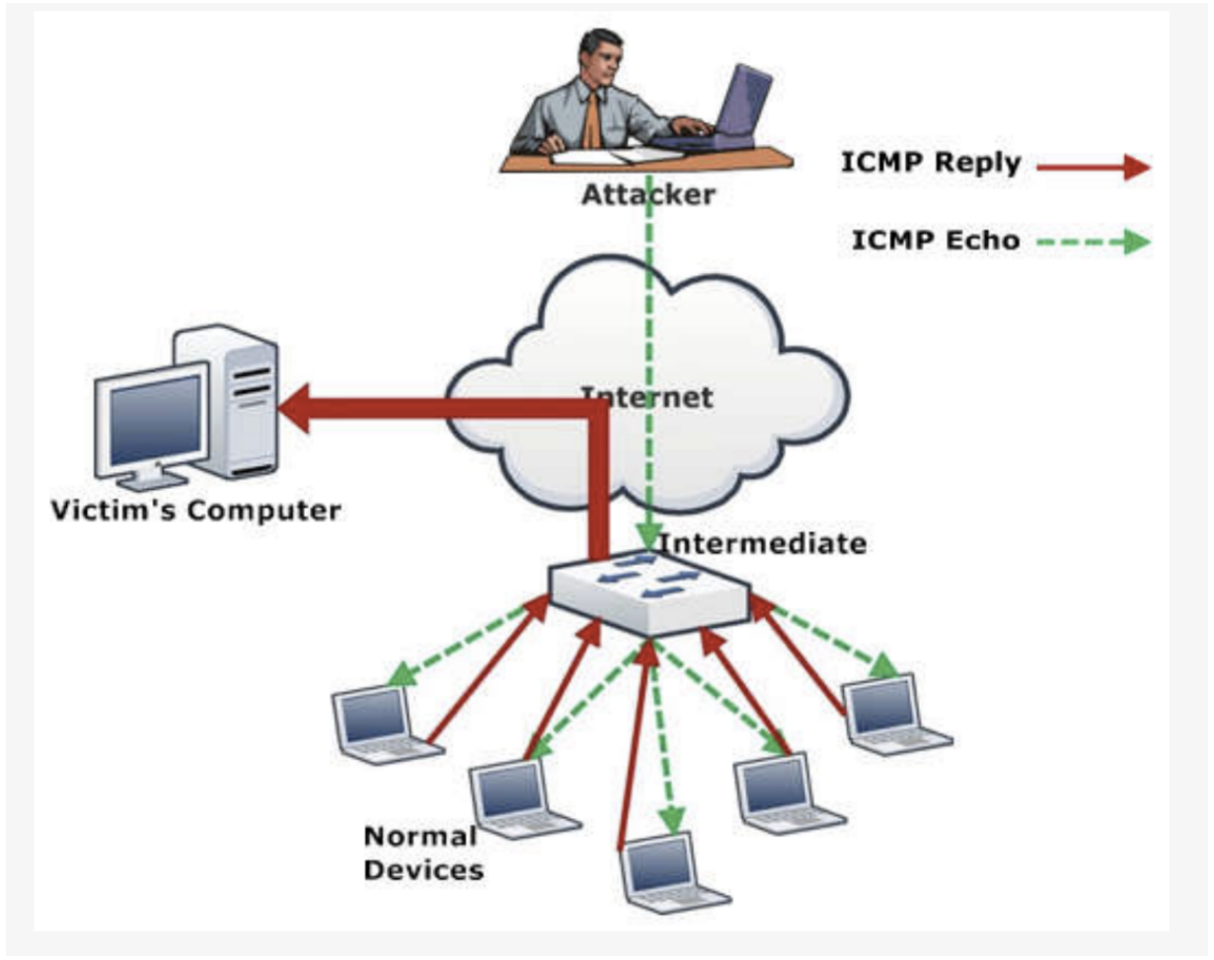

Slide 56
5.3.2 Existing Security Mechanism:
1. DDoS Mitigation Services: Utilize specialized DDoS mitigation services such as Cloudflare, Akamai, or Arbor
Networks, which can detect and mitigate large-scale DDoS attacks.
2. Web Application Firewalls (WAF): Employ Web Application Firewalls to filter out malicious traffic and protect
against application-layer DDoS attacks.
3. Use of IDPS: Deploy Intrusion Detection and Prevention Systems to recognize and halt DDoS attacks by detecting
established patterns of such attacks.
4. Traffic Control: Employ methods such as rate limiting and traffic shaping to regulate network traffic flow and avert
system overloads.
5. Content Delivery Networks (CDN): Employ Content Delivery Networks to spread inbound traffic over several
servers, thereby diminishing the severity of DDoS attacks.
6. Anycast Networking: Apply Anycast networking techniques to disperse network traffic over various locations,
effectively reducing the severity of large-scale DDoS attacks.
7. Redundant Infrastructure: Establish redundant infrastructure with failover capabilities to maintain system
availability in the event of an attack.
8. Application of Load Balancers: Utilizing load balancing tools to evenly distribute incoming traffic across numerous
servers, ensuring no single server bears excessive load.
9. Data Backup and Recovery: Consistently back up essential data and establish a strong recovery plan to quickly
restore services following an attack.

Slide 57
10. Security Audits and Penetration Testing: Perform frequent security assessments and penetration tests to
discover and address potential weaknesses exploitable in DDoS attacks.
11. Ongoing Network Surveillance: Implement continuous network monitoring to identify and tackle DDoS attacks
promptly. Establish a detailed incident response strategy for effective and swift attack mitigation.
12. Blockchain-Specific Protections: In a blockchain-based system, ensure that the network has sufficient
decentralization to prevent attacks on individual nodes from affecting the entire network. Implement
cryptographic measures and consensus algorithms that provide additional protection against DDoS attacks.

Slide 58
5.3.3 Better Solutions:
Uncle blocks: The defense mechanism against Uncle blocks BDoS has been specifically tailored to counter Nakamoto consensus-based cryptocurrencies like Bitcoin, but its effectiveness varies when applied to different cryptocurrencies, including Hyperledger Fabric. This variance in effectiveness can be attributed to the inherent uncle block mechanism in Hyperledger Fabric, which provides incentives to miners who successfully mine blocks directly linked to the primary blockchain.
This characteristic disrupts BDoS attacks because, even if a rational miner does not emerge as the winner of the mining competition, their block still receives a reward. As a result, when an attacker publishes a block header, it no longer significantly diminishes the expected profits of rational miners within the Hyperledger Fabric
network.
It’s crucial to emphasize that this approach doesn’t offer incentives to blocks that aren’t directly linked to the primary blockchain. This leaves room for the possibility of alternative attack strategies that could potentially reduce the expected reward, such as publishing two-block headers to create a fork from the most recent block in the chain. However, conducting a detailed design and investigation of such potential attacks falls beyond the scope of this research within the context of Hyperledger Fabric.
Disregarding Attacker’s Blocks in the Mining Competition: Another potential approach to mitigate the impact of the attack involves altering the behavior of miners so that, in the event of a blockchain fork, miners prioritize blocks that were not generated by the attacker. However, the key challenge lies in distinguishing attack blocks from legitimate ones. Employing a third-party service for this purpose is not feasible as it contradicts the decentralized principles of the system and opens the door to false accusations. Instead, we propose a classification method based on the time gap between receiving the block header and receiving the complete block. In cases of non-attack blocks, we can reasonably assume that this time interval remains within a certain bound, such as one minute. Blocks with longer intervals are deemed suspicious in this context.

Slide 59

6. HMIS DApp Demo

Slide 60
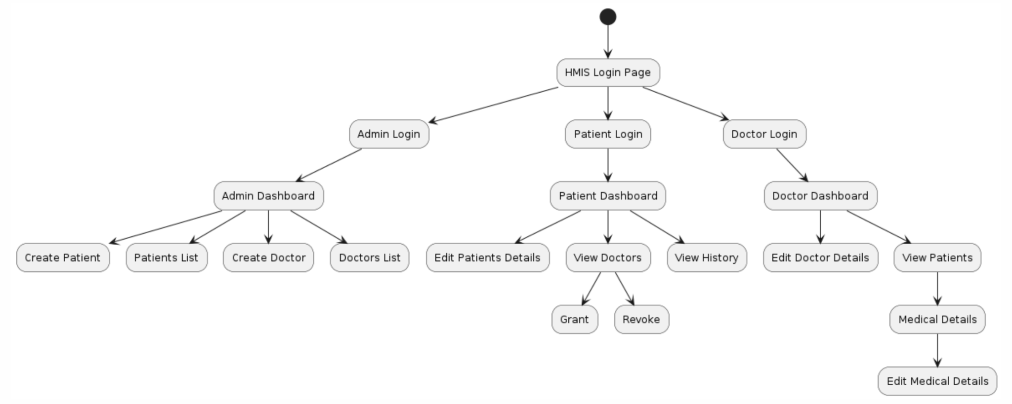

Slide 61
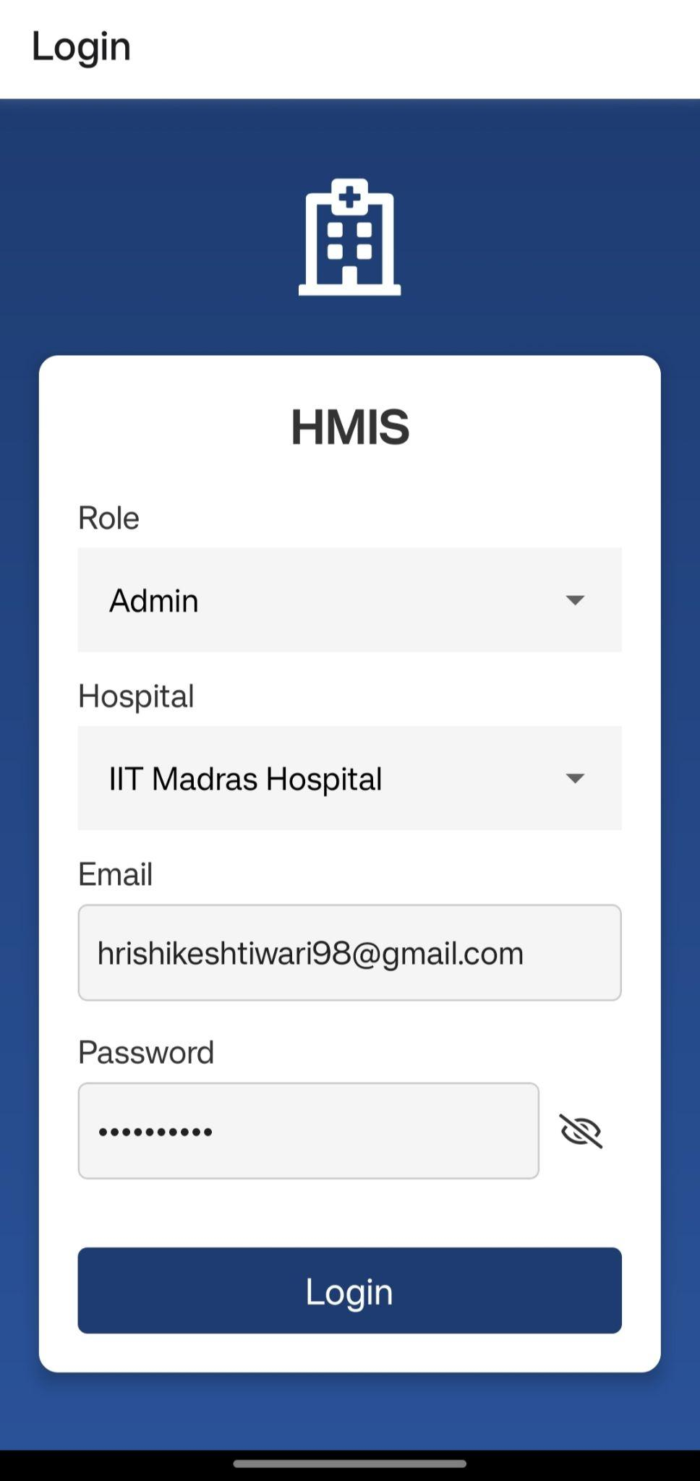
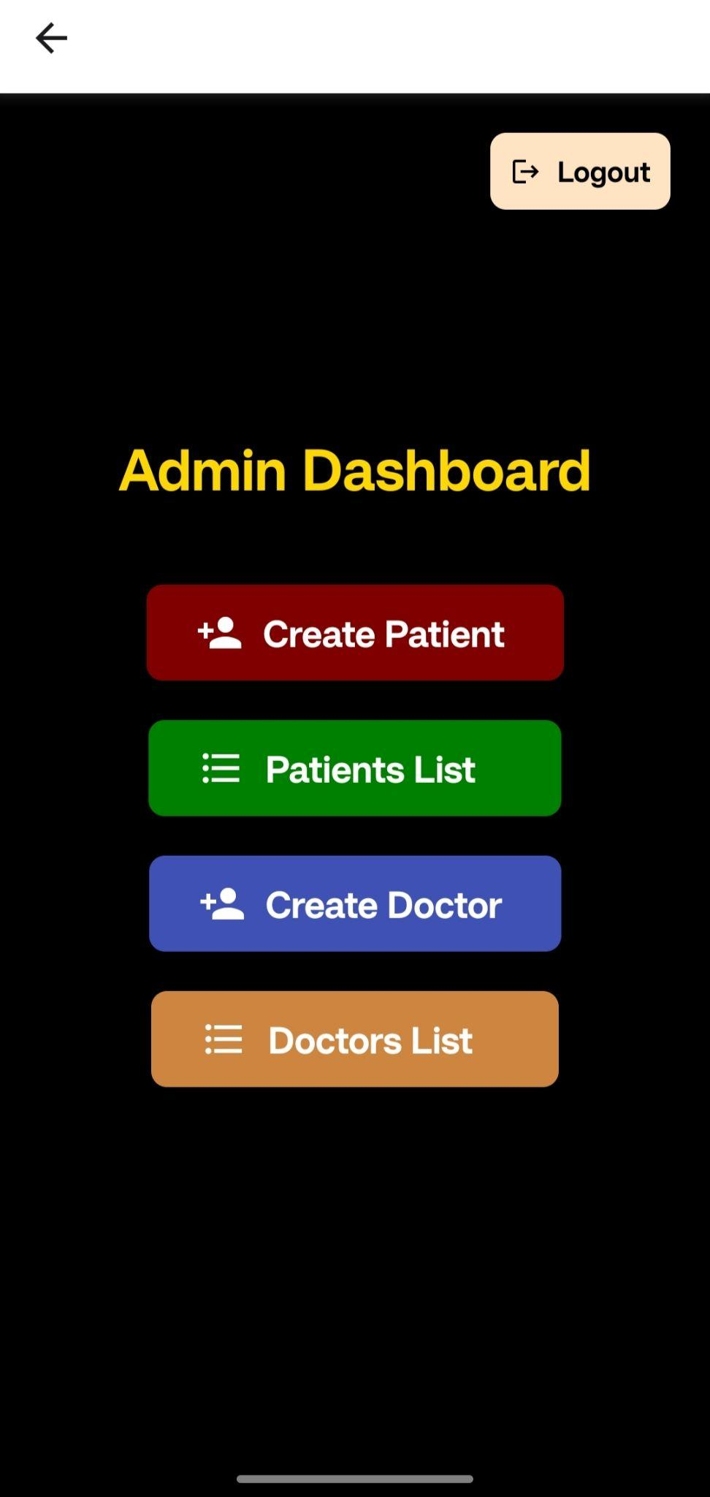
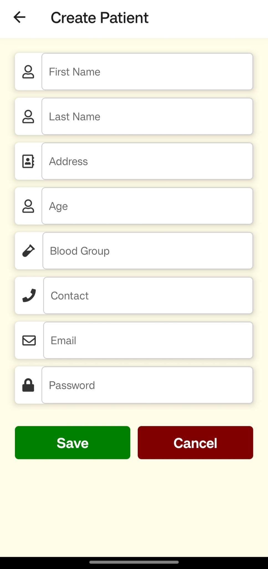

Slide 62
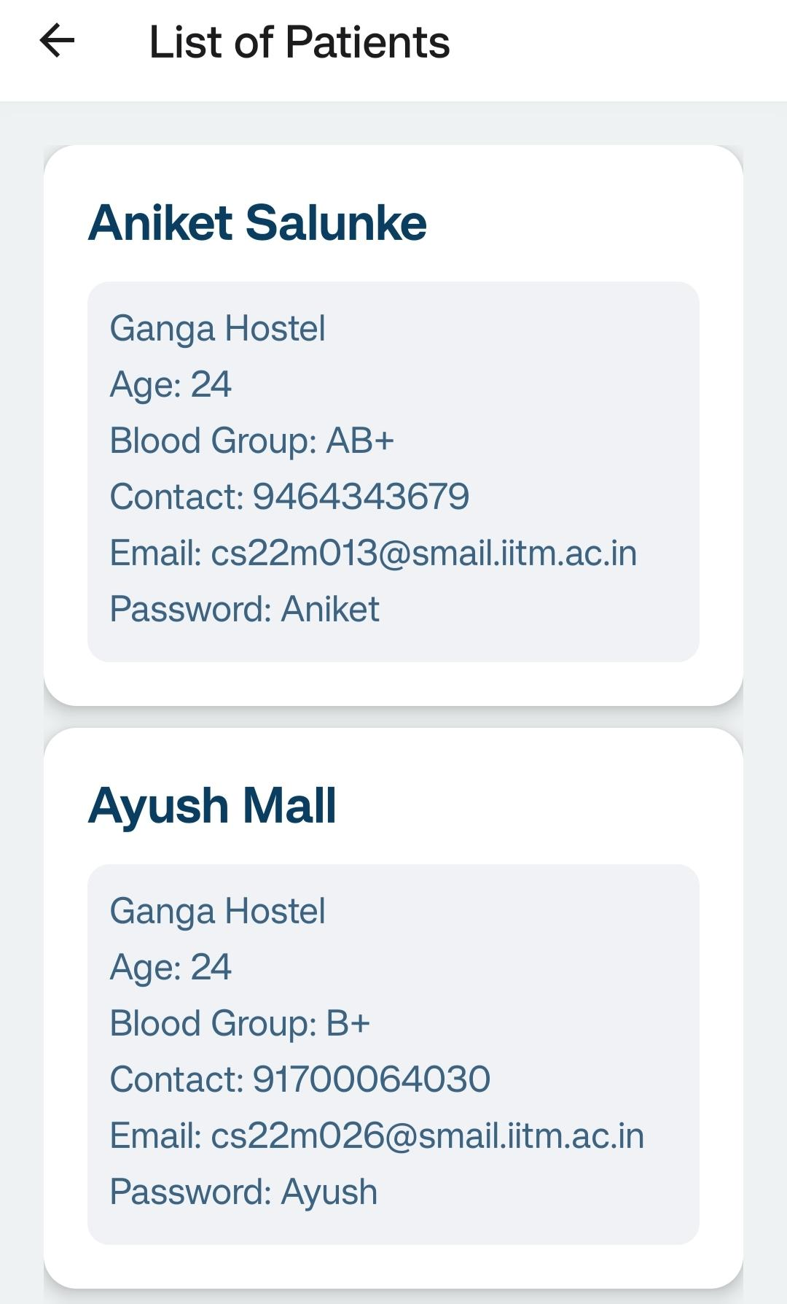
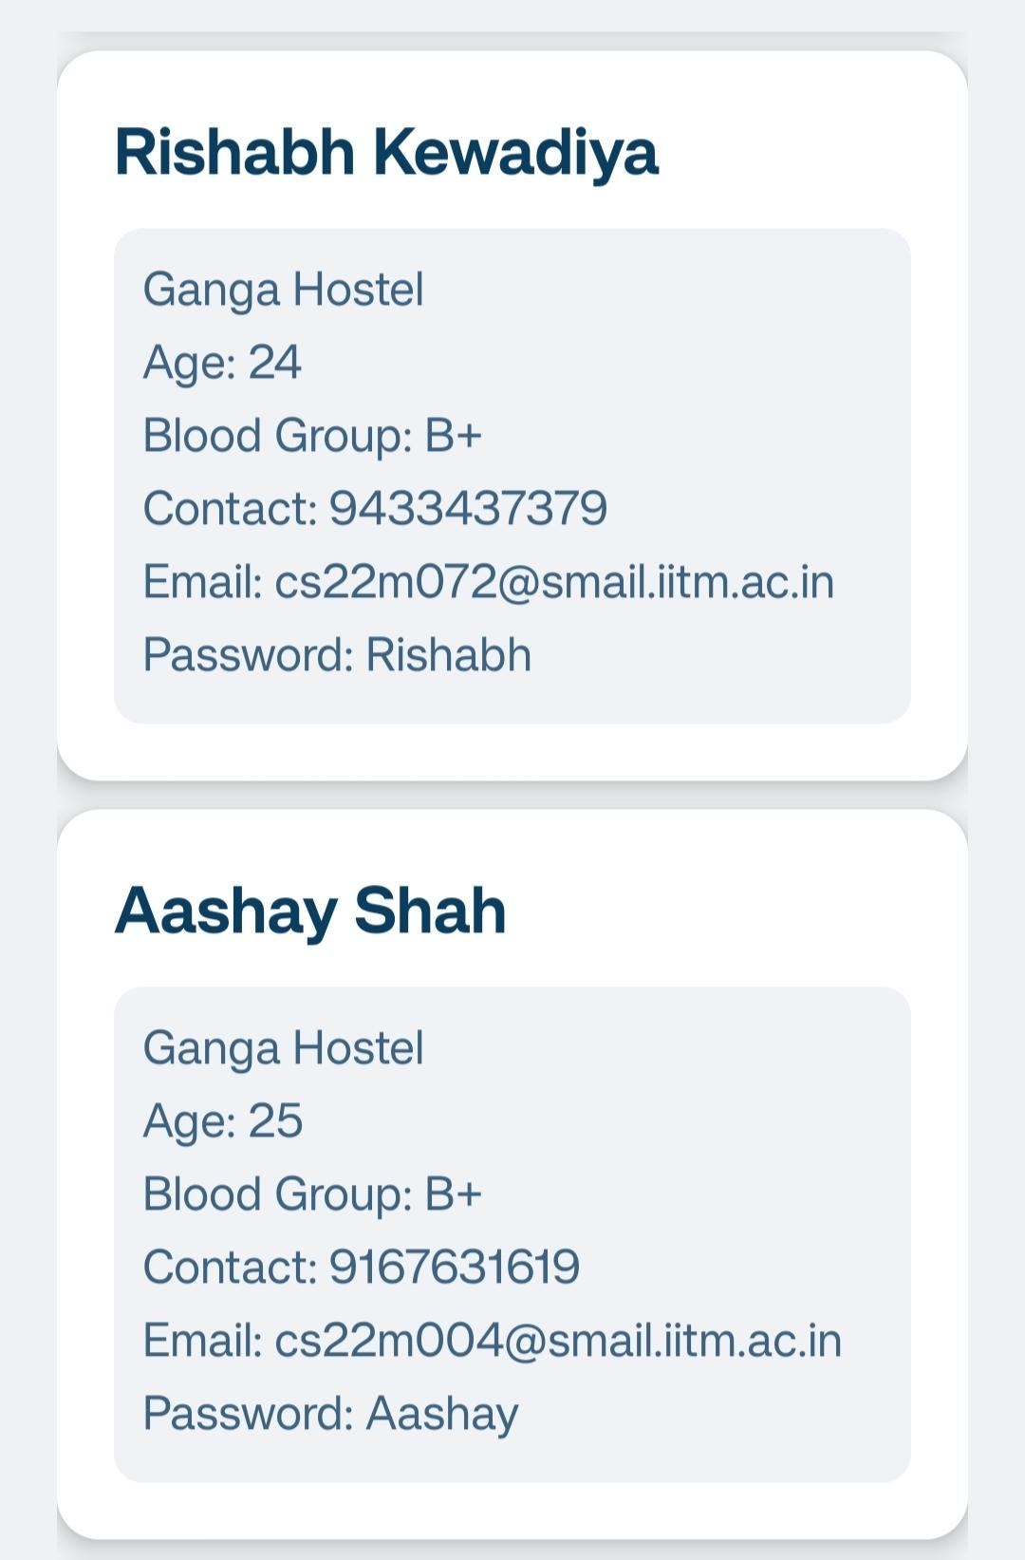
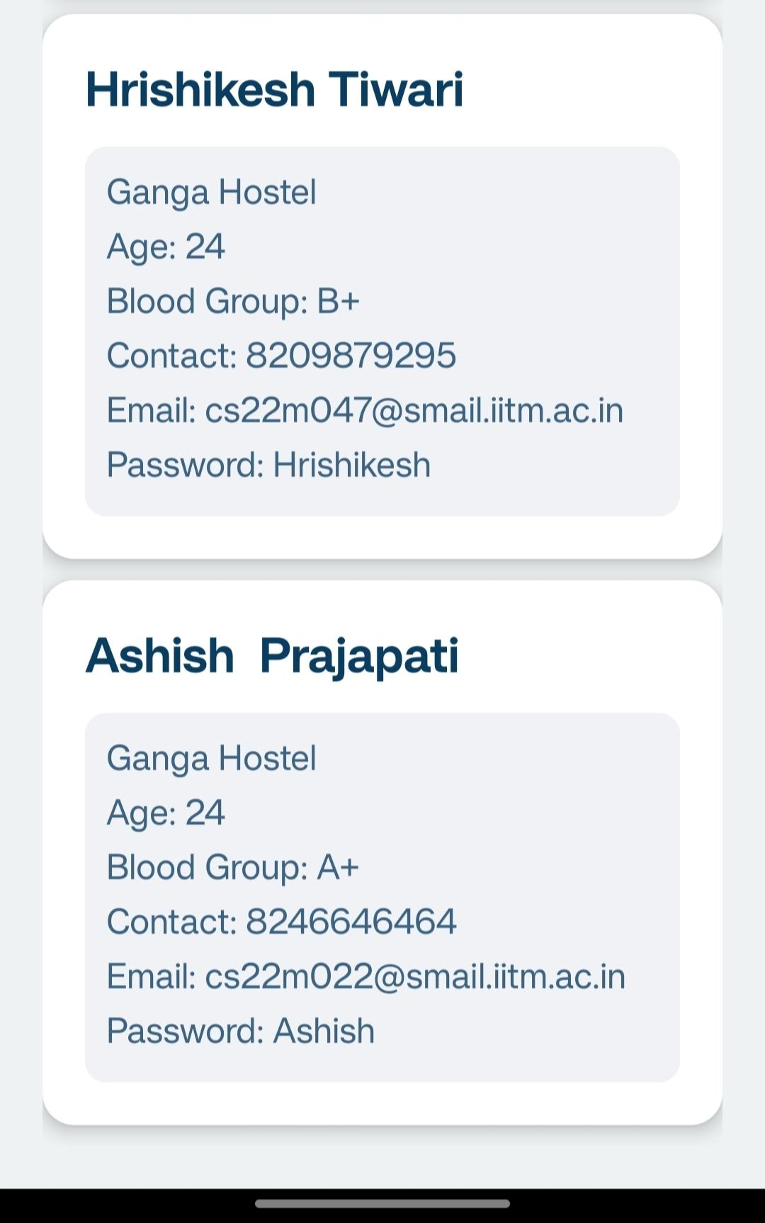

Slide 63
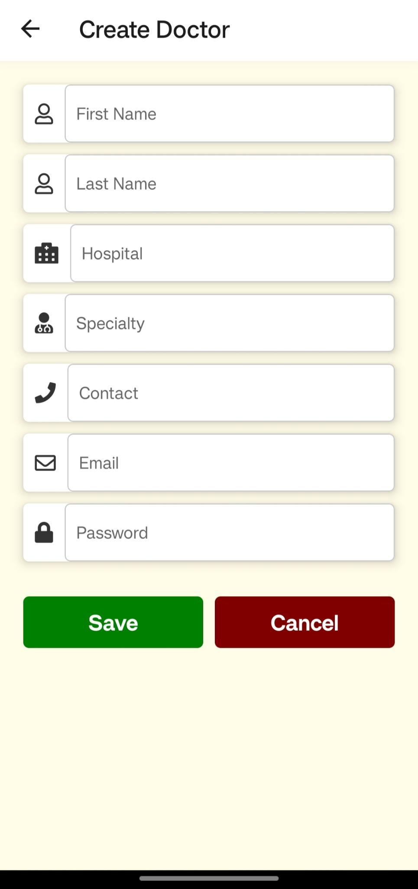
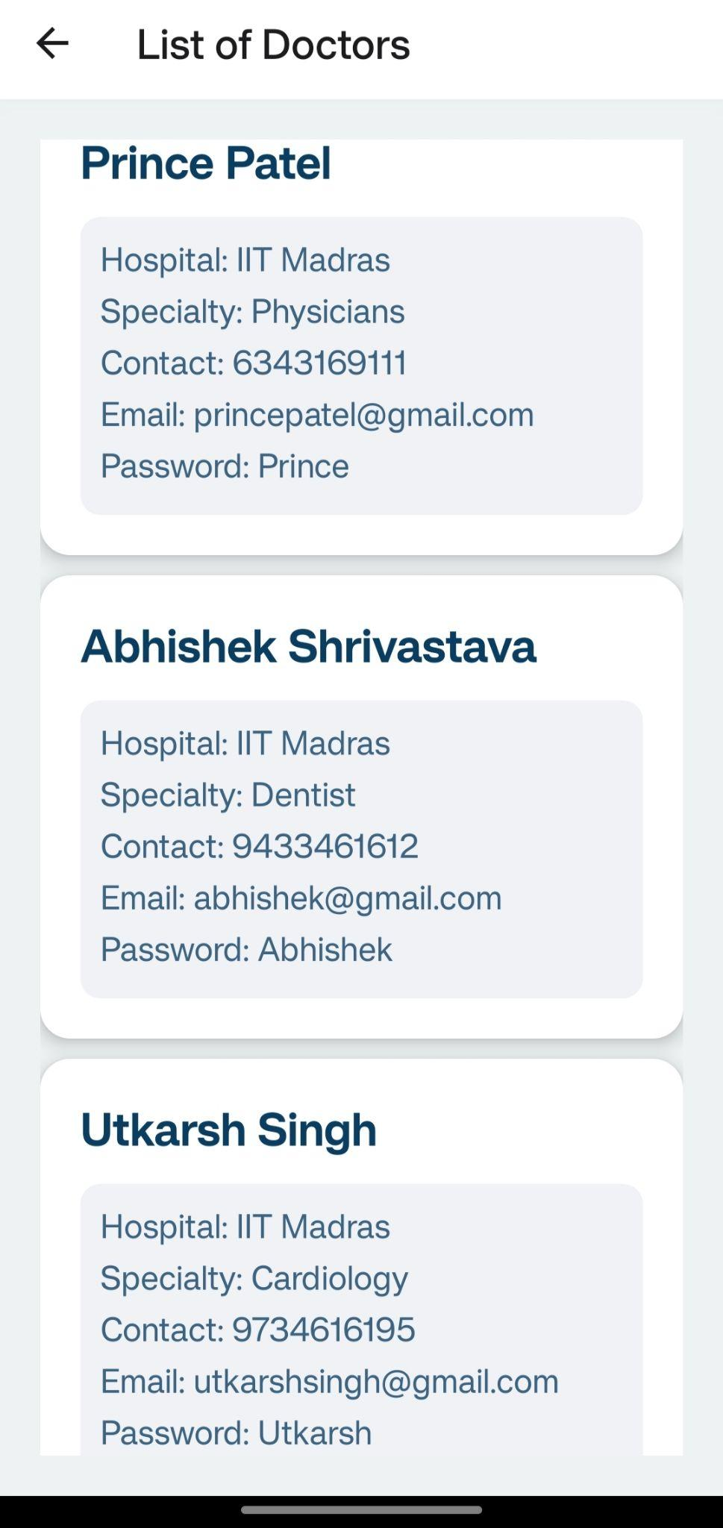

Slide 64
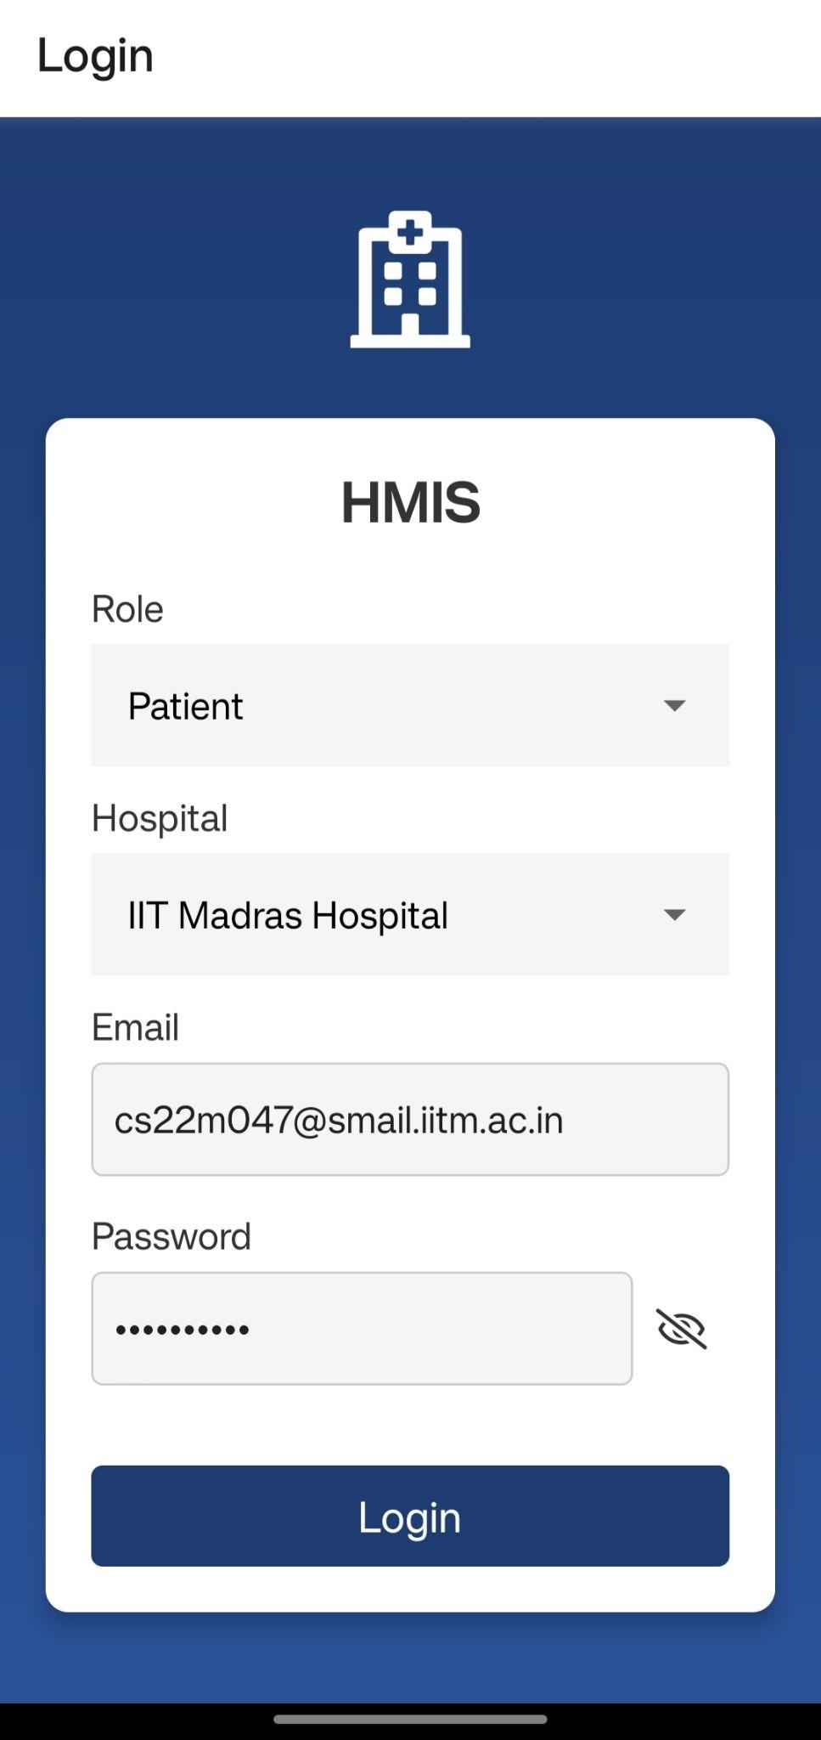
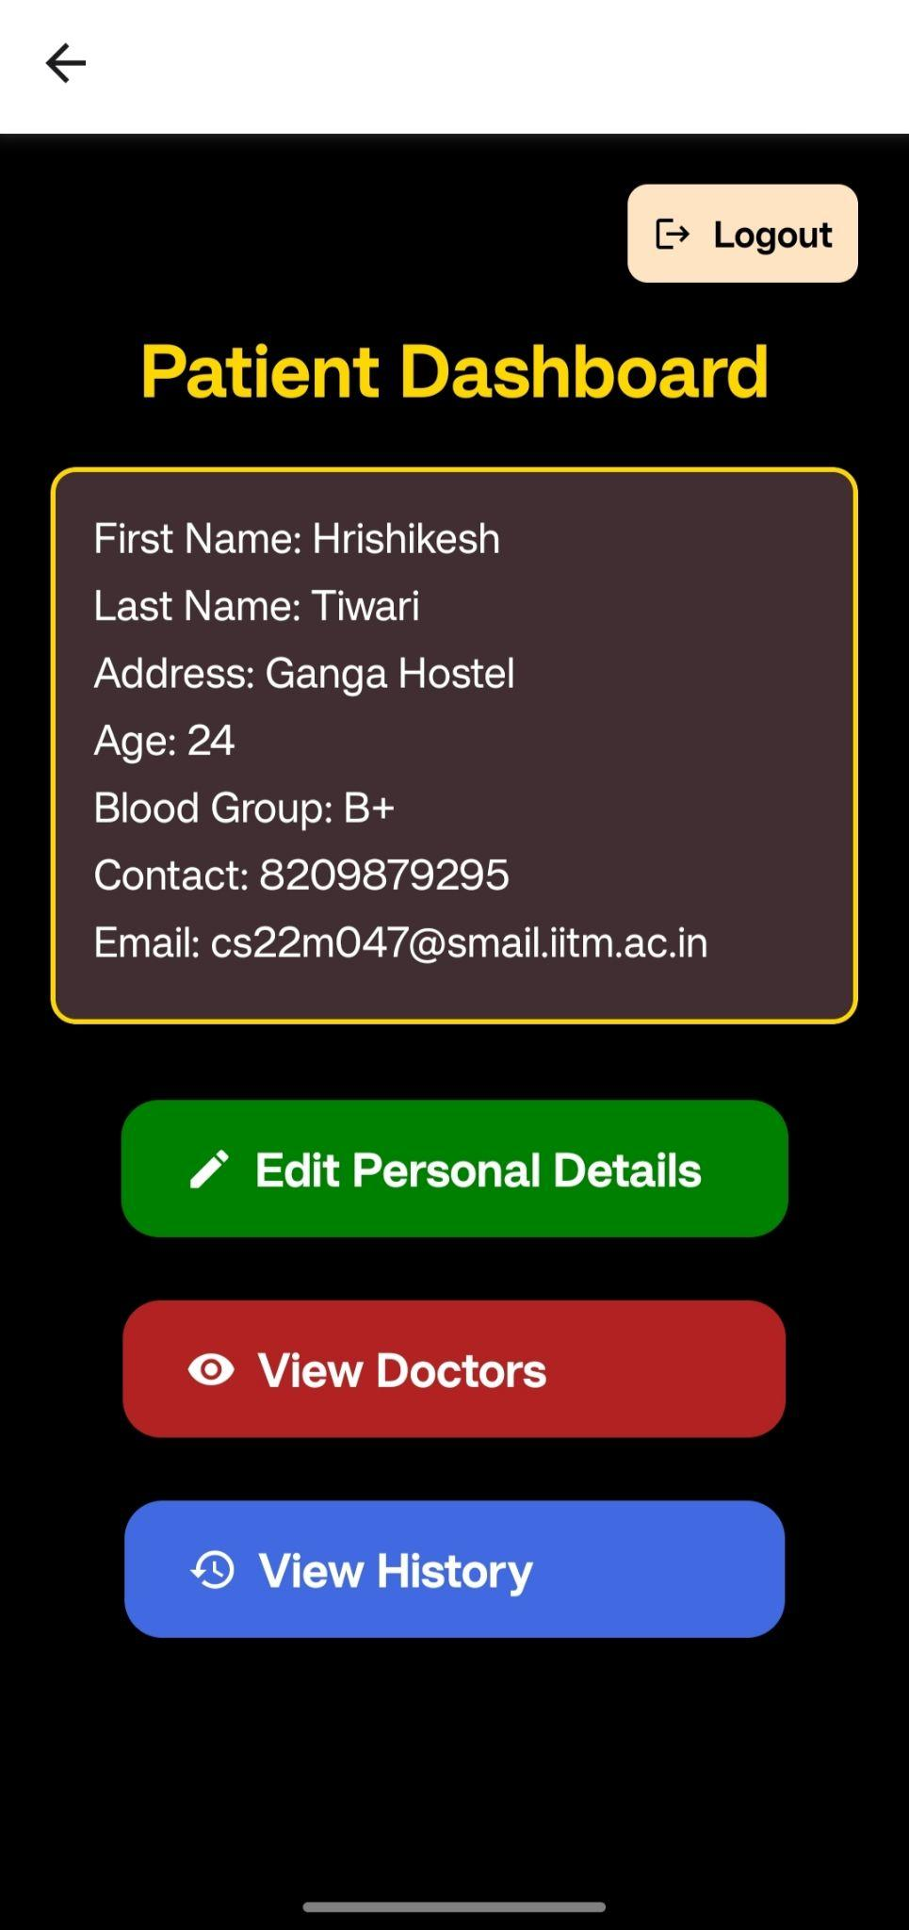
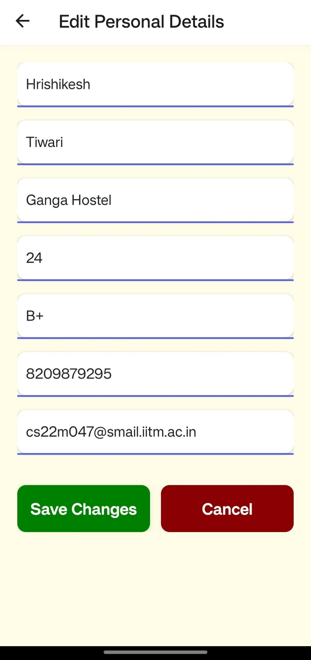

Slide 65
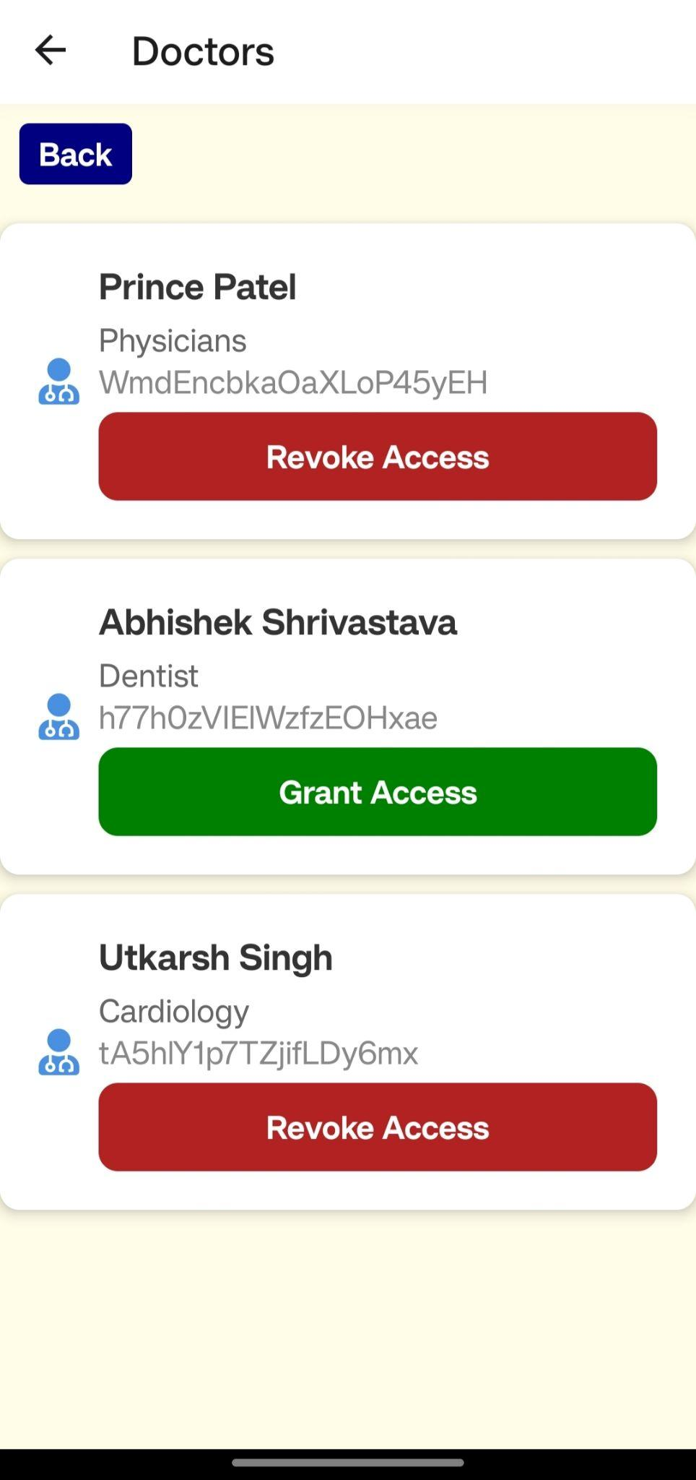


Slide 66
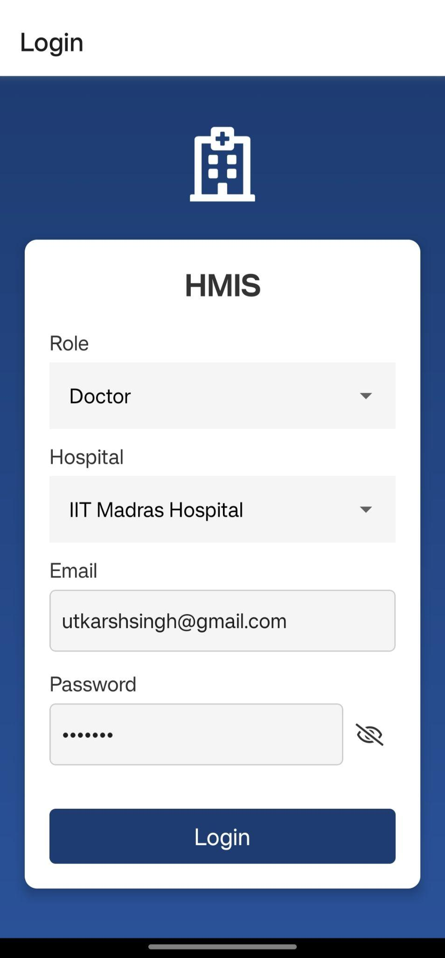
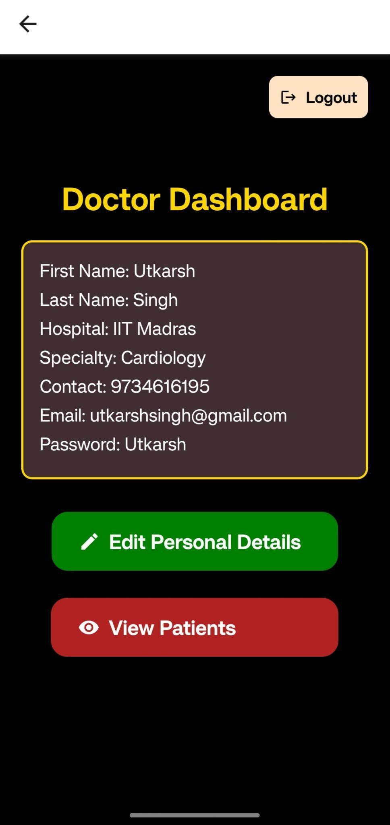
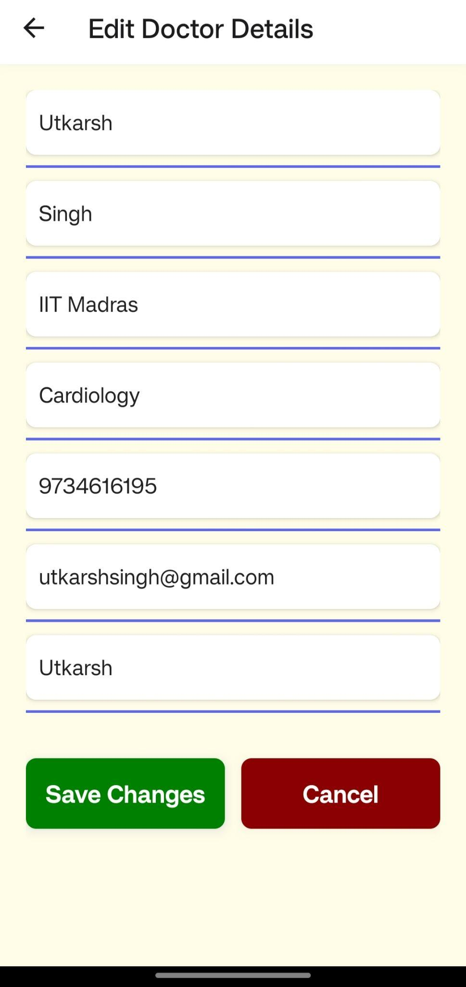

Slide 67
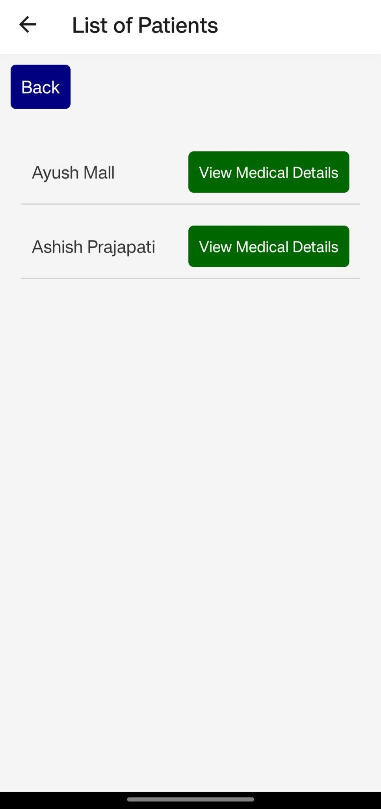
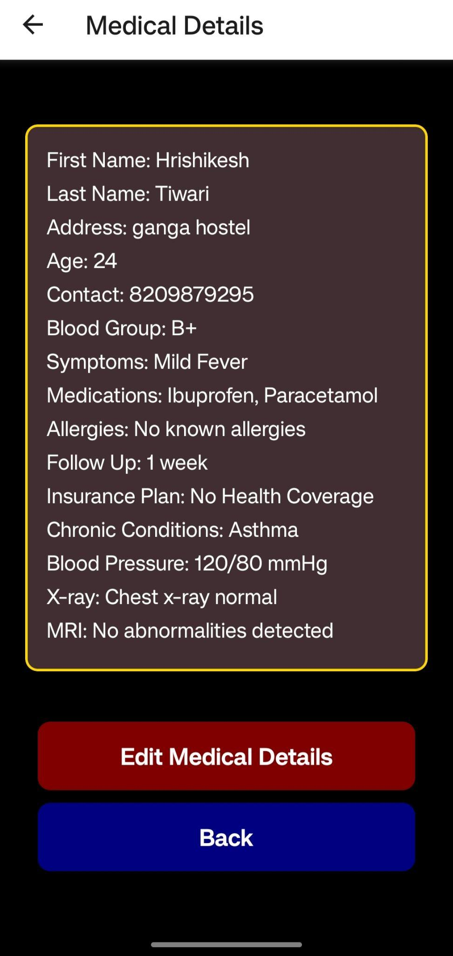
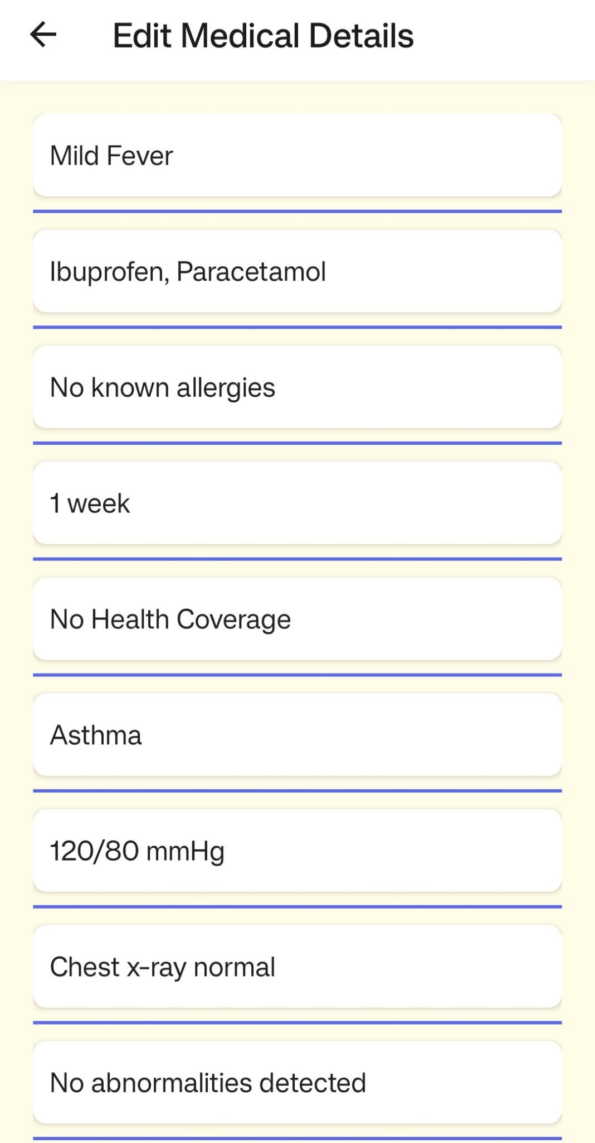


Slide 68
7. FrontEnd and BackEnd

Slide 69

React Native
- Framework by Facebook for native mobile app development using JavaScript and React
- Enables coding once and deploying on both iOS and Android platforms
- Facilitates development for multiple platforms using a single codebase
Expo Go
- Free app on iOS and Android for viewing and testing React Native projects on real devices
- Allows viewing projects without compiling app binaries every time a change is made
- Streamlines development and testing process with QR code scanning
Firebase
- Platform by Google for creating mobile and web applications
- Offers tools and services for building high-quality apps, enhancing performance, and expanding user base
- Features include analytics, databases, messaging, crash reporting, authentication, and file storage

Slide 70
4. initializeApp and getFirestore
- initializeApp: Initializes Firebase application instance using configuration object
- getFirestore: Gets instance of Firestore, Firebase's NoSQL cloud database
- Used to interact with Firestore database for operations like reading, writing, updating, and listening to data
5. Firebase Database
- Realtime Database for cloud-hosted NoSQL database
- Facilitates storage and real-time synchronization of data among users
- Features JSON format storage and declarative security rules for data protection
6. Authentication
- Firebase Authentication for backend services and SDKs to authenticate users
- Supports various methods including email/password, social media accounts, and phone numbers
- Integrates with Firebase services and third-party providers for user authentication management

Slide 71
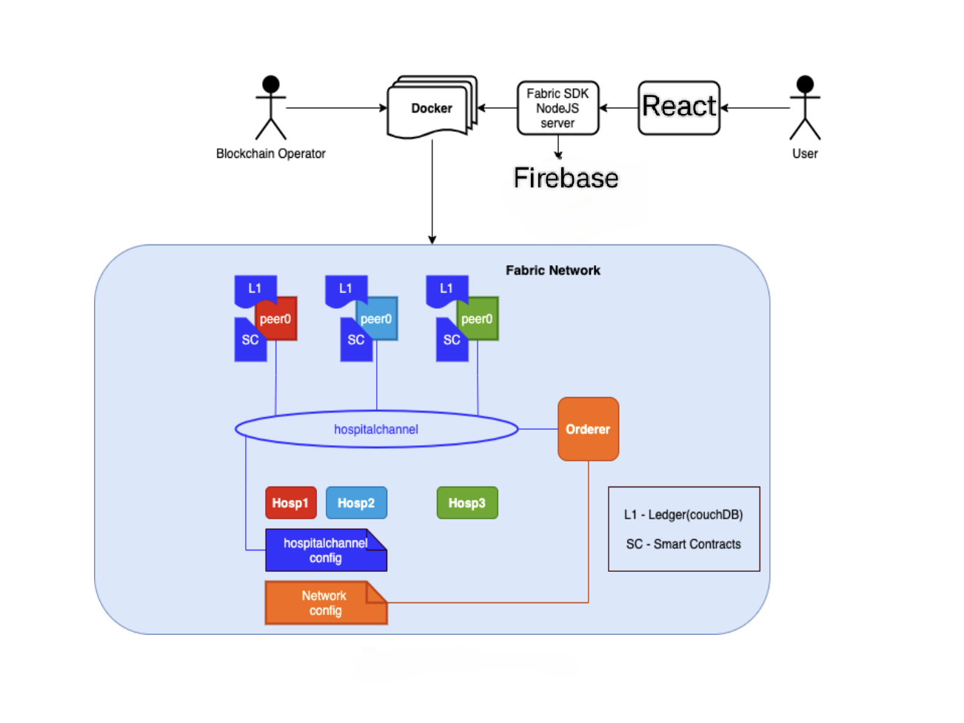
7. Architecture Flow

Slide 72
8. JSON Web Token (JWT)
A JSON Web Token (JWT) is a compact method for representing claims shared between two parties. It comprises three parts: a header, a payload, and a signature. The header typically includes the token type and hash algorithm. The payload carries claims, usually about a user, along with other data. The signature verifies that the token has not been tampered with. JWTs are commonly used in authentication and data exchange processes due to their compact format, ideal for inclusion in HTTP headers or URL query parameters.
9. Authorization with JWT
1. User Authentication: The user logs in with credentials (e.g., username, password).
2. Generate JWT: Upon successful authentication, the server creates a JWT containing user claims and other data needed for authorization, signing it with a secret key or key pair.
3. Send JWT to Client: The server sends the JWT back to the client, usually in an HTTP response.
4. Client Stores JWT: The client stores the JWT, often in local storage, session storage, or an HTTP-only cookie.
5. Client Sends JWT in Requests: For subsequent requests, the client includes the JWT, typically in the Authorization header using the Bearer schema.

Slide 73
6. Server Verifies JWT: Upon receiving a request with a JWT, the server verifies the token's signature to ensure validity and integrity, checking that it was created by the server and has not been altered.
7. Server Processes Claims: If the token is valid, the server reads the claims to determine if the user is allowed to perform the requested action (authorization). For example, the claims might indicate admin privileges.
8. Grant or Deny Access: Based on the claims and other information (e.g., permissions in a database), the server decides to allow or deny the action.
9. Respond to Client: The server sends a response back to the client, providing the requested resource for valid requests or an error message for unauthorized, invalid, or expired tokens.
10. Generate Access Token
The `generateAccessToken` function creates a JWT access token for authentication. It signs a payload containing user information and an expiration period with a secret key, returning the signed token. This token is used by the client to make authenticated requests to the server, with the server verifying the token to grant access to protected resources.

Slide 74
11. API’s
APIs (Application Programming Interfaces) enable communication between software applications by defining rules and tools. They specify methods like GET (retrieve data), POST (create data), PUT (update data), and DELETE (remove data). Developers use these methods to request and exchange information over the internet.
Endpoints:
POST /createPatient: Creates a new patient, handling validation, network connection, ID generation, contract calls, and user registration.
POST /createDoctor: Creates a new doctor, validating roles, storing credentials, and registering the doctor.
GET /getAllPatients: Retrieves all patient assets, handling role validation, network connection, and contract calls.
GET /getAllDoctors: Retrieves all doctor assets, handling role validation, network connection, and contract calls.
PUT /updatePatientMedicalDetails: Updates a patient's medical details, validating user role, connecting to the blockchain, and invoking a smart contract function.
GET /getDoctorById: Retrieves a specific doctor's details based on ID, validating user role and hospital ID.

Slide 75
GET /getPatientById: Retrieves a patient's details based on ID, handling role validation and network connection.
PUT /updatePatientPersonalDetails: Updates a patient's personal details, accessible only by the patient, and handling role validation and network connection.
GET /getPatientHistoryById: Retrieves the transaction history of a patient's record, handling role validation and network connection.
GET /getDoctorsByHospitalId: Fetches all doctors associated with a specific hospital ID, handling role validation and network connection.
POST /grantAccessToDoctor: Allows a patient to grant access to their records to a specific doctor, handling role validation and network connection.
POST /revokeAccessFromDoctor: Allows a patient to revoke access from a doctor, handling role validation and network connection.
POST /login: Authenticates users and returns access and refresh tokens.
POST /token: Generates a new access token using a valid refresh token.
DELETE /logout: Invalidates the refresh token to end the session.

Slide 76
12. Process of making API’S Public - Ngrok
Ngrok is a tool for exposing local servers to the internet securely. It provides a unique URL that allows access to your local server from anywhere, making it great for testing webhooks, APIs, and other server applications during development.
Install Ngrok: Download and install Ngrok.
Run Ngrok: Start Ngrok with the command ngrok http <port> in your terminal, replacing <port> with your local server's port number.
Access Ngrok URL: Ngrok generates a unique URL that tunnels traffic to your local server, allowing external access.
Testing and Development: Share the Ngrok URL with clients to test APIs in a real-world environment. Requests to the Ngrok URL are forwarded to your local server, aiding in debugging and development.
Secure Communication: Ngrok supports HTTPS, encrypting traffic between clients and your local server for security during testing and development.
Monitoring and Management: Ngrok provides a web-based dashboard for monitoring traffic, inspecting requests, and managing tunnels. It helps track usage and debug API issues.

Slide 77
8. Deployment

Slide 78
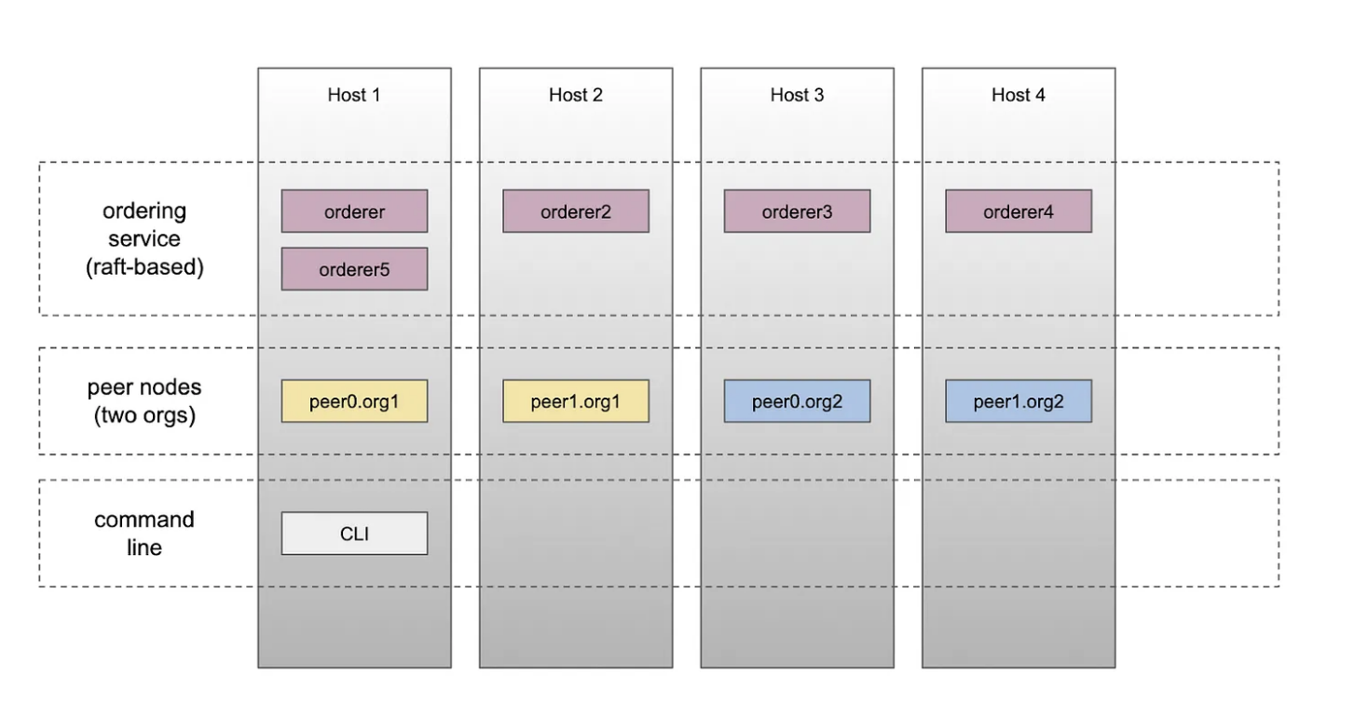
ARCHITECTURE SETUP

Slide 79
Architecture Setup:
Ordering Service (Raft-based): Manages transaction sequencing and replication, ensuring fault tolerance and high availability.
Peer Nodes (Two Organizations): Maintain the decentralized ledger and execute smart contracts, validating transactions and ensuring ledger consistency.
Command Line Interface (CLI): Utility for network administration, smart contract deployment, and transaction triggering.

Slide 80
Tools and Technologies for Hyperledger Fabric Deployment:
Docker: Enables application development, deployment, and management through containerization, ensuring consistent operation across environments.
Docker Compose: Simplifies the management of multi-container Docker applications using a YAML configuration file.
Docker Swarm: Facilitates the clustering and orchestration of Docker hosts, offering features like load balancing and auto-scaling for production deployments.
VMs Used for Deployment:
VM1: ccd079@192.168.25.102
VM2: ccd080@192.168.25.103
VM3: ccd081@192.168.25.104
VM4: ccd082@192.168.25.105

Slide 81
Deployment Steps:
Install Docker and Docker Compose.
Open necessary ports for Docker Swarm.
Install Hyperledger Fabric.
Create an overlay network with Docker Swarm.
Clone the repository on all hosts.
Bring up each host using corresponding scripts.
Create a channel and join all peers to the channel.
Deploy chaincode on all peers.
Challenges Encountered:
Complexity in Setup and Management.
Docker Swarm Leader Election Issue.
Docker Container Communication Issue.

Slide 82
9. Challenges

Slide 83
Hyperledger Fabric in Healthcare
1. Architectural Complexity
- Intricate architecture
- Limited support for storing MRI reports and high-resolution images
2. Limited Database Support
- Supports only LevelDB and CouchDB
- Used Firebase for Real-Time Data Sync, Authentication, Security
- Requires careful planning for integration due to data handling differences
3. Limited API Support
a) Native Cryptocurrency APIs: Fabric lacks native support for cryptocurrencies
b) Public Internet-Facing APIs: Requires custom gateways for public APIs
c) Mobile-Specific APIs: External tools or services needed for mobile integration
4. Access User Attributes Using Client
- Doctor's details inaccessible to patients due to uniform client permission settings
- Admin user required for retrieving doctor information

Slide 84
5. Challenges in Developing Application
- Securing patient data at peer level poses significant challenges
- Issues with data re-encryption due to Node.js limitations
- Challenges with generating and accessing public keys
- Scaling peers within hospital organizations faces obstacles, including fabric-peer container failures
and incomplete peer configurations in ccp files

Slide 85

10. Future Scope

Slide 86
Enhancements for Production-Grade Application using Hyperledger Fabric
- Address security challenges for patient record protection. Refine Fabric's modular nature for better
adaptability. Integrate additional hospitals and peers efficiently
- Use Apache Kafka for managing multiple ordering nodes effectively as the network expands
Network Communication and Security
- Use HTTPS for transport-level security (TLS). Encrypt passwords transmitted from front end to back end
using HTTPS. Implement password reset feature and enhance UI/UX for better user interactions
Data Management and Search Functionality
- Verify Hyperledger Fabric's support for wildcard searches before adding search functionality
- Note that frequent search queries may be infeasible due to data originating from multiple databases
Consortium Policy and Wallet Management
- Construct consortium policy to meet pBFT's minimum consensus requirements. Allocate wallet based on
distribution of organizational peers. Associate users in wallet with their respective peers
- Consider using NoSQL database for wallet housing and replication across multiple nodes to prevent
data loss
5. Enhancing Interoperability
- Aim to enhance interoperability with other health information systems
- Facilitate seamless data exchange and integration across different platforms and healthcare providers

Slide 87
Thank You

